Slide 1
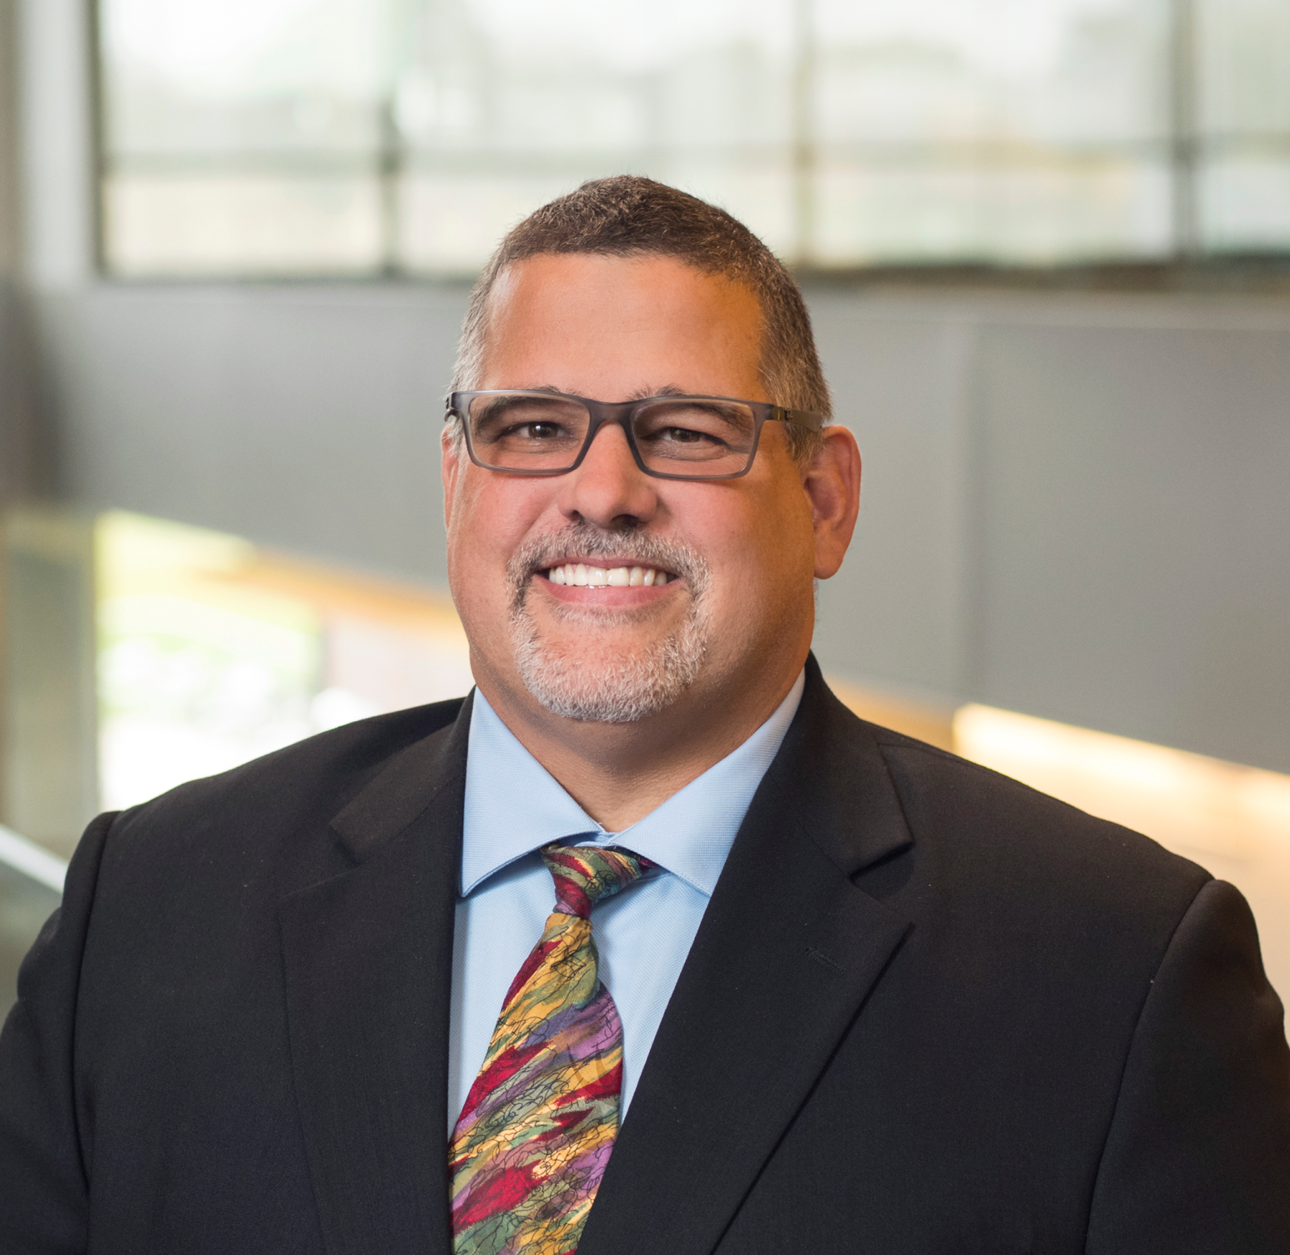
Guest Speaker Introduction Cyber Security for Home, Work, & Travel
Todd Riley, Cyber Security Manufacturing Leader at Goodyear, is responsible for establishing the manufacturing cyber strategy, along with driving the implementation of cyber initiatives across Goodyear’s 60 factories worldwide. He liaises with global manufacturing, engineering, IT, and local plant teams to increase Goodyear’s cyber defenses. Since 1988, Todd has held various positions throughout manufacturing IT. He holds an Electrical Engineering degree from The University of Akron and lives in Green, Ohio with his wife Kerri, daughter Grace, and guinea pig Tchai. Todd enjoys golfing, billiards, and bow hunting.
Todd E. Riley, CISM
Cyber Security Manufacturing Leader
(330) 283-4166 (c)
todd_riley@goodyear.com
https://www.linkedin.com/in/todd-riley-762683/

Slide 2
Cyber Security for Home, Work, & Travel an overview of a few notorious business incidents and the impacts experienced the challenges we face today a review of some basic security considerations September 27th, 2022

Slide 3
Let's Scare you a Bit!

Slide 4
CyberCrime Statistics from 2020
7 million new phishing and scam pages created according to the FBI.
Nearly 3 out of 4 companies experienced a phishing attack.
Ransomware attacks grew by more than 40% during the pandemic.
Forbes reports an average of 26,000 incidents per day.
NOTE: Phishing, smishing and vishing are all methods of identity fraud that differ in how scammers contact you—by email, text or phone—to steal personal details or financial account information.

Slide 5
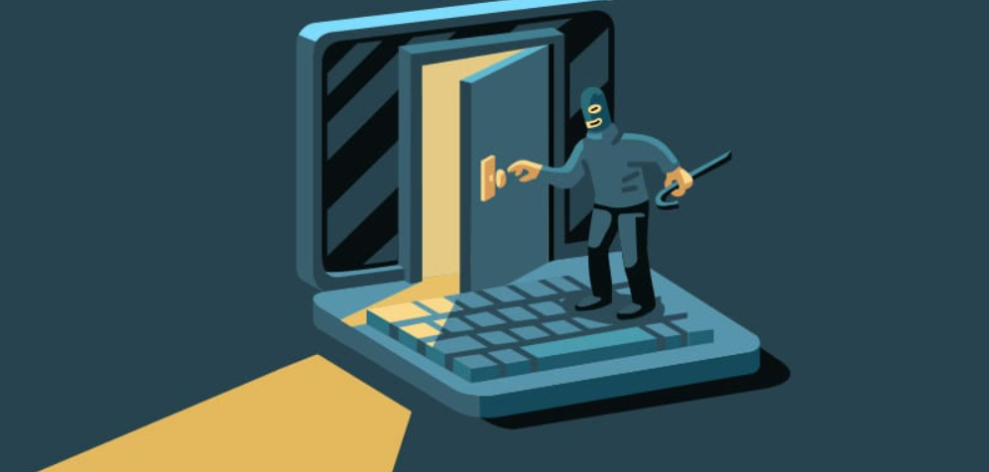
Should you be Afraid of Cyber Crime?
The 2017 Untold Story of NotPetya, The Most Devastating Cyberattack in History A Nation State Attacked Ukraine Based Companies
Total ~10 BILLION Total Damages
Some Reported Losses:
$ 1.3B Merck Pharmaceutical company
$ 400M FedEx Shipping company
$ 384M Saint-Gobain French construction company
$ 300M Maersk Danish shipping company
$ 188M Mondelez Snack company
What went wrong
A Vulnerable Vendor
Accounting software M.E.Doc on a single computer
One unpatched XP system
A few minutes to spread
Notes:
Maersk Ransomware Attack
ME Doc, software accounting software, is owned by Linkos Group who got hacked.
Subsequent update of ME Doc contained patches AND the malware.
49,000 PCs,
7,000 Servers,
149 Domain controllers
All backups gone, all Business systems, No idea of shipments, customers, invoices, etc.
Encrypted in 7 minutes took several weeks to recover.
Luckily, due to a power outages, 1 DC was still in tact in Ghana, Africa. The recovery/rebuild was taking place in the UK, but the Ghana IT associate didn’t have a Visa to the UK. So an IT guy from UK met the Ghana IT guy in Nigeria to get the only copy of the domain controller.
Protections:
Intrusion Prevention Systems (IPS)
Cold storage backups
Network segmentation
Different admin passwords (PAM) on each server
Regular vulnerability patching

Slide 6
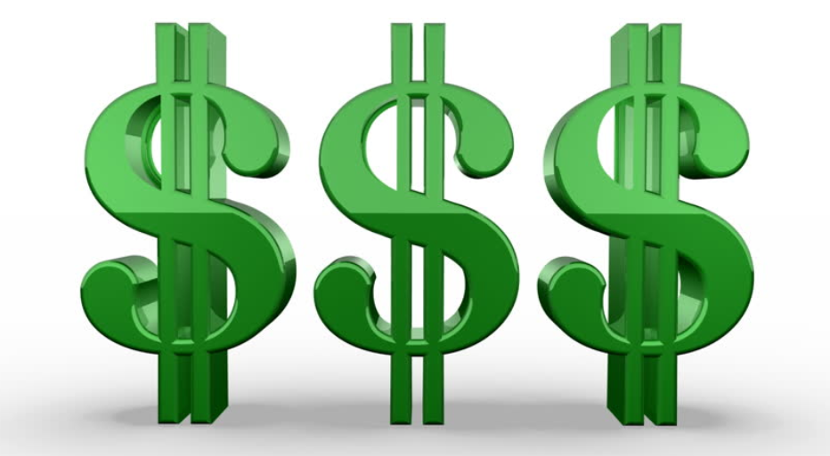
Privacy Regulations - Protecting Consumer’s Rights
Examples:
California’s Consumer Privacy Act
EU’s GDPR (General Data Protection Regulations)
Company with Data Breach | Records Lost (2021)
Cognyte | 5 Billion
LinkedIn | 700 Million
Facebook | 533 Million
Bykea | 400 Million
Brazilian Ministry of Health | 223 Million
Follow Best Practices:
Never Collect more data than the business requires
Never keep data longer than needed
GDPR Maximum Fines:
Data Breach 20 million or 4% of the company’s global annual income.
Don’t Loose PII (Personal Identifiable Information)

Slide 7
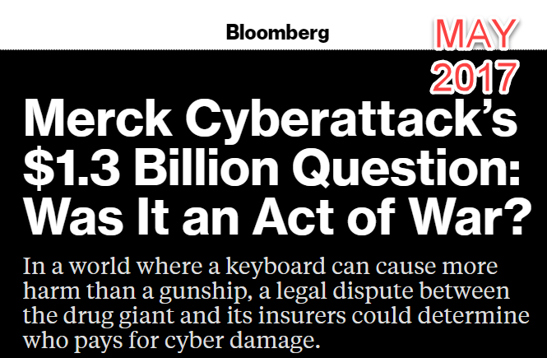
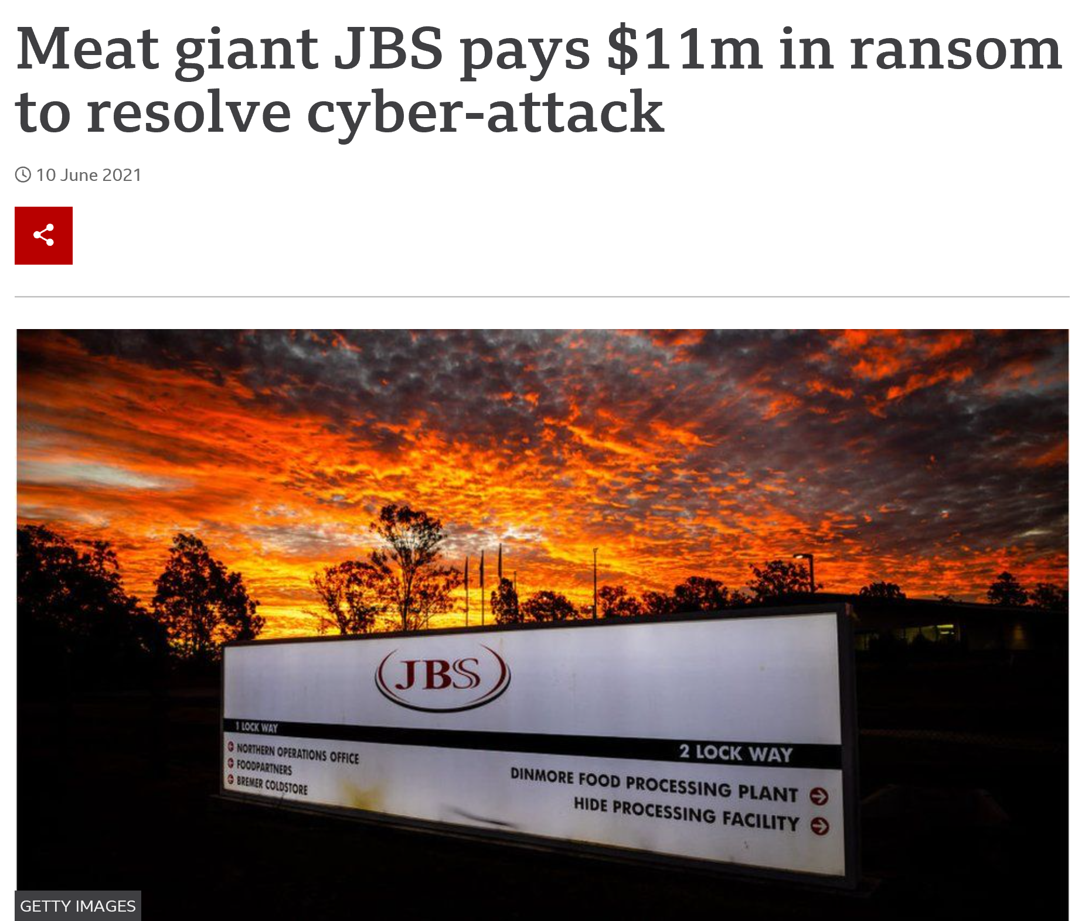
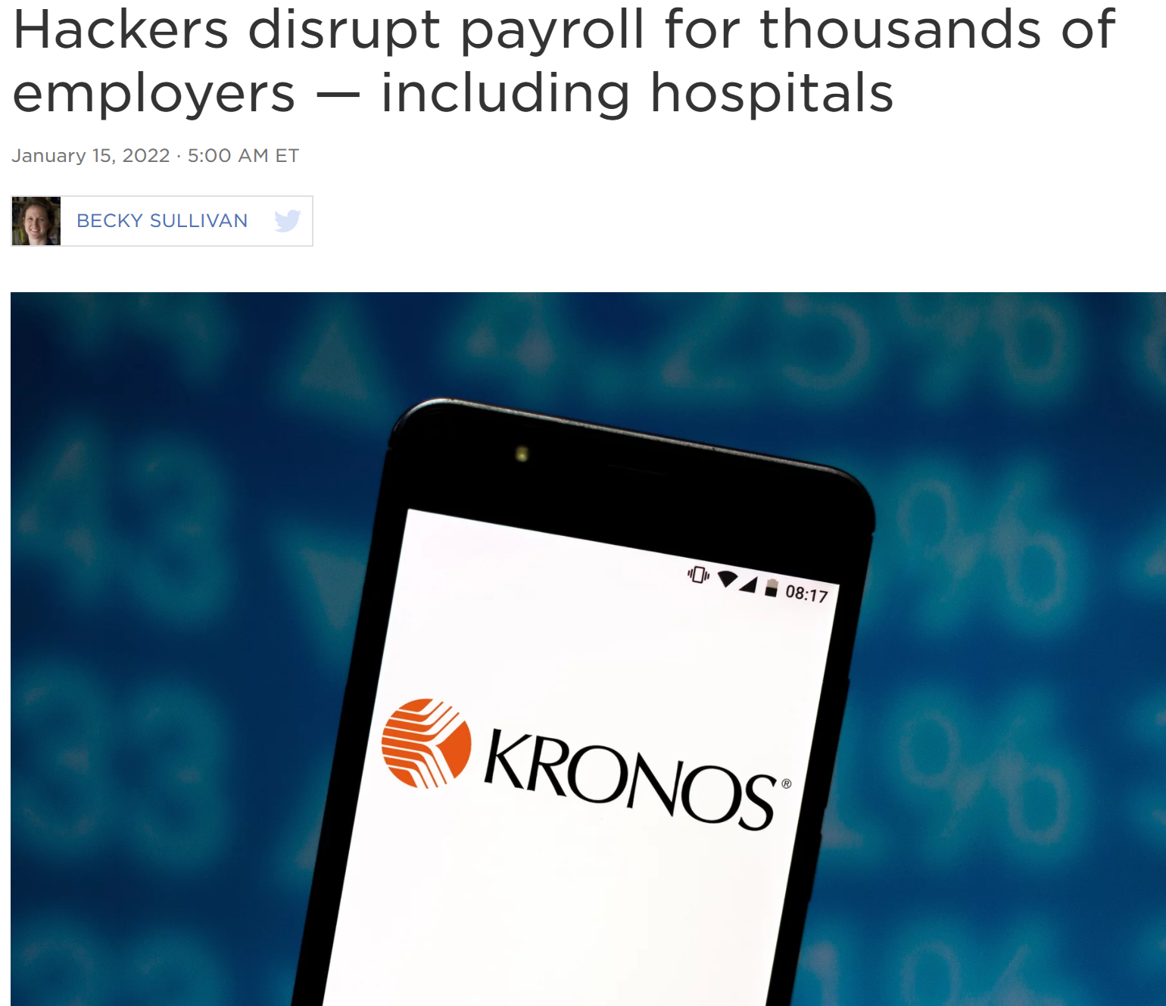
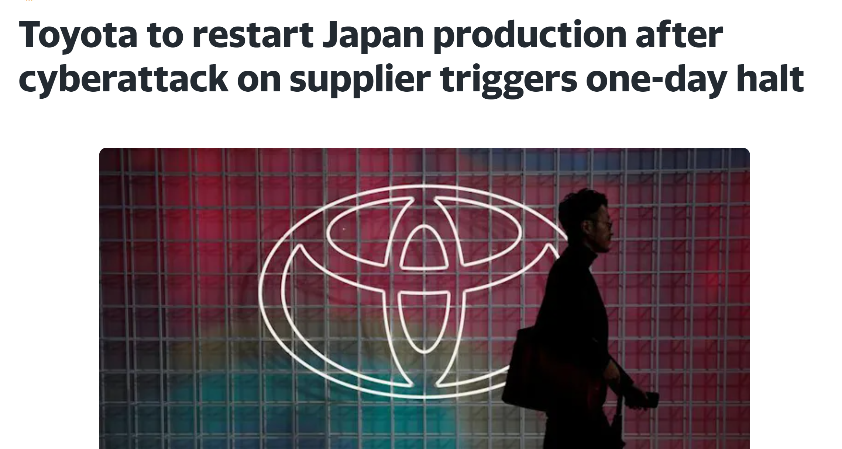
Recent Cyber Incidents + Many More
JBS 11MM
Sued Cyber Insurance Company
NO GAS
Notable 2022 Cyber Events
Crypto.com – Account Compromise
In January, one of the largest cryptocurrency exchanges, Crypto.com, released a statement explaining they were the victim of an account compromise attack that resulted in 4,836.26 Ethereum and 443.93 Bitcoin being stolen, totalling approximately $35 million.
Supplier Plastic Parts
Time & Attendance Pay Checks
Notes:
One thing to note, Network Segmentation is just the FIRST layer of defense against Cyber Attack. Other protective measures are still needed. For Example, Anti viruses on Servers and Laptops, disabling usb ports etc. Implementing Network Segmentation will enable us to segment/disconnect an individual plant from other plants in case of an intrusion.

Slide 8
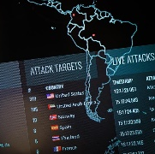
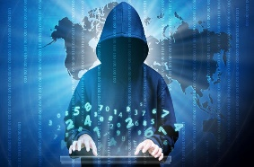
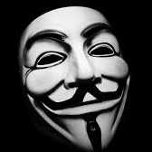
Threat landscape – who are the adversaries?
Nation State Actors
Criminals
Individuals and organizations who are paid by a government to obtain information, such as corporate secrets and intellectual property, by executing targeted attacks, often in a stealth mode in order to bypass detection. They often spend a lot of time and resources to execute attacks. They are motivated by nationalism and tasked with gaining secrets from or disrupting other nations via cyber means.
Cybercriminals are people who use technology to commit malicious acts on digital systems or networks with the intent to generate profit, personal gain, or to extort by selling or ransoming stolen sensitive company information or personal data, or by threatening to launch inflammatory online campaigns to spread disinformation.
Since 2014, Cyber Criminals made MORE money than drug traffickers!
Hacktivists
Insiders
An individual or organization who misuses a computer system or network to bring attention to a political or social cause.
An insider threat is a malicious threat to an organization that comes from people within the organization, such as employees, former employees, contractors or business associates, who have inside information concerning the organization's security practices, data and computer systems.

Slide 9
So, what can we do?
NIST CSF Layers of Defense:
Identify
Protect
Detect
Respond
Recover

Slide 10
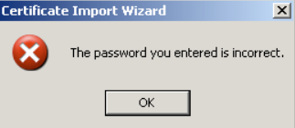
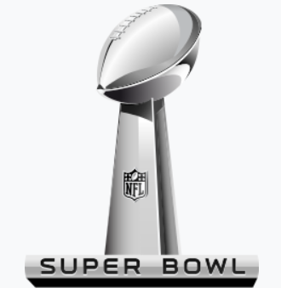
Cyber Security Is Everyone’s Responsibility
Apparently, you can’t use “beefstew” as a password.
It’s not stroganoff.
Don't use “incorrect” as a password…
just because you get reminded
Use a Pass Phrase: Cl3v3landBr0wnsAreSuperbowlChamps! (LOL - this would never be guessed!)

Slide 11
How Strong is your password? Password Strength Checker
Cl3v3landBr0wnsAreSuperbowlChamps!
Don’t type in your actual passwords, but something similar to gauge strength!
44 quattuordecillion Years
45 Zeros!!!
GreenBay
Instantly
A rainbow table is a precomputed table for reversing cryptographic hash functions, usually for cracking shorter password hashes.
Always use 15+ long passwords with additional complexities when allowed.

Slide 12
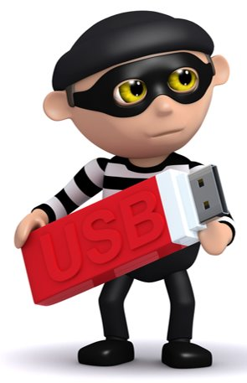
Stuxnet – Malicious Computer Worm An Attack on IRAN’s Nuclear Plants
Ruined one-fifth of Iran's nuclear centrifuges used to generate fuel!
USB drives are dangerous:
Never pick up a random USB drive and plug it into your device​
Be cautious when using a USB that has been shared with someone else​
Don’t store sensitive or confidential data on a USB drive​
Protect your data​
Use encryption

Slide 13
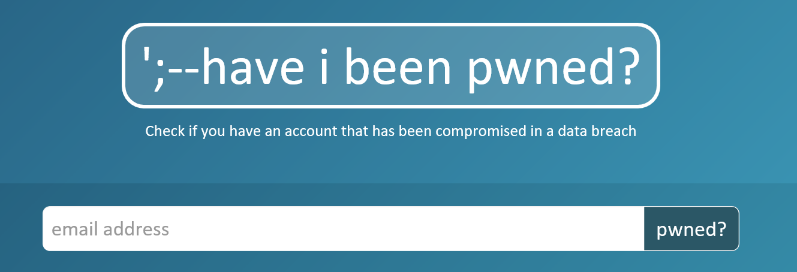
Cyber Security At Home
Check to see if your email has been compromised in the past:
https://haveibeenpwned.com/
Periodically change your passwords

Slide 14
Cyber Security At Home, Work, & Traveling
NOTE: The following are general recommendations and might not apply to every situations.
Always follow the recommendations of your local IT staff who know your specific use cases.

Slide 15
Cyber Security At Home
• Update All Operating Systems – It’s important to run the latest and patched operating system such as Windows 10, Android, MacOS, or IOS. Don’t use legacy operating systems that don’t get security updates that leave your system vulnerable to attack.
• Remove Unwanted Applications – Frequently, remove unnecessary applications that you no longer use. The more software you have installed, the more vulnerabilities that are introduced.
• Use Firewalls – Ensure that your firewall is always patched and running. This prevents attackers from directly attacking your system.
If you only remember two things today:
• Unique Passwords – Use unique passwords for every account that you have including social media accounts. If you need help keeping track of them, try using a password keeper like lastpass.com or 1password. Your EMAIL password is VERY critical since other systems use it for password reset.
• Enable MFA – Always enable Multiple Factor Authentication whenever offered. Secure access should use something you know and something you have e.g. Biometrics (face or fingerprint), Authenticator Apps, or even the less secure text codes.

Slide 16
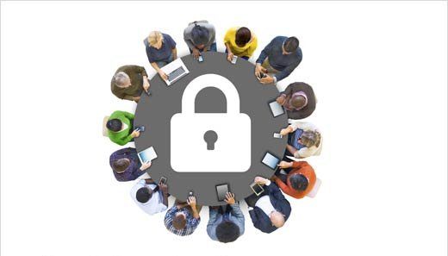
Cyber Security at Work
Company Email Address – Do not use your company email address for personal business (e.g., LinkedIn account). Never use your work passwords/phrase on external non-work sites.
• Security Questions – Use answers that only you will know and not information that can be obtained from social media about you (e.g., dog’s name, child’s name, favorite sports team, etc.)
• Ensure Updates – It’s important to download the latest operating system, application, and anti-virus updates to protect against an attack.
• Lock Your Computer – It’s important to lock your computer when you are not using it (CTRL+ALT+DEL then Lock). You don’t want others looking at your work or accessing information on your device.
Shut Down Your PC – when your workday is done. There are two reasons: 1) No one can break into a device that is turned off. 2) Restarting installs any pending updates.
Report Suspicious Behavior – IP theft is real. Report suspicious behavior to your security department.
• Be Alert Opening Email – Read all emails carefully. Validate who the sender is, be cautious if the email has a sense of urgency, look for misspelling or poor grammar. Were you expecting the email?

Slide 17
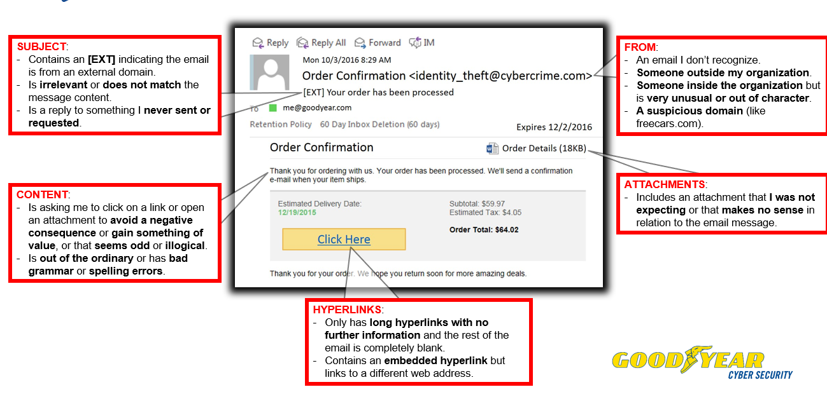
How to identify Malicious Email Red Flags

Slide 18
Cyber Security at Work
• Business Email Compromise - Verify all payment account changes rather than relying solely on an email. Contact the company using the information on file. Communicate using voice converstation.
• Controls – Know what controls are in place and follow them. If someone asks you to deviate, contact your supervisor.
• No Plugins/Add-ons – Extra software downloaded could be malicious and cause harm e.g. a Key Logger that steals your password.
• Macros – Disable auto-run of macros when opening Microsoft Excel.
• Phone Calls – Always verify who you are talking to on the phone. Do not give out passwords or secure information over the phone.
• Computers – Never install unauthorized applications or external media on your work computer.
• Fraud – If you suspect your company is a victim of fraud, escalate immediately! The first 24 hours are crucial to recovering funds.

Slide 19
Cyber Security Traveling
• Disable Auto Connect – Do not allow your laptop/smart device to auto connect.
Public WiFi – do not use it. If traveling to a high-risk location, use personal hot spot and use a VPN connection.
Bluetooth – disable it. Just another digital entrance to your private information.
Social Media Posts – avoid them. Do not tell your family and friends on Facebook where you are going to dinner or where you are vacationing. Wait until you are home to post.
Working with Others Around You –If you work with sensitive data, obtain a privacy screen for your laptop. People should not have clear access to see what you are working on.
Clean Desk – Never leave papers on your desk when they may contain sensitive or private data.

Slide 20
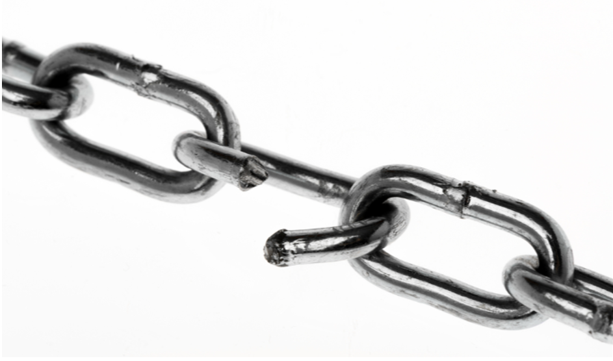
Cyber Security Is Everyone’s Responsibility
Don’t Be the Weak Link

Slide 21
Summary
This concludes my presentation on:
Cyber Security at Home, Work, and While Traveling
As you can see:
Cyber Security is Everyone’s Responsibility

Slide 22
Cyber Security Is Everyone’s Responsibility
Questions OR Feedback
Bonus Material: Facebook Hacked vs Spoofed

Slide 23
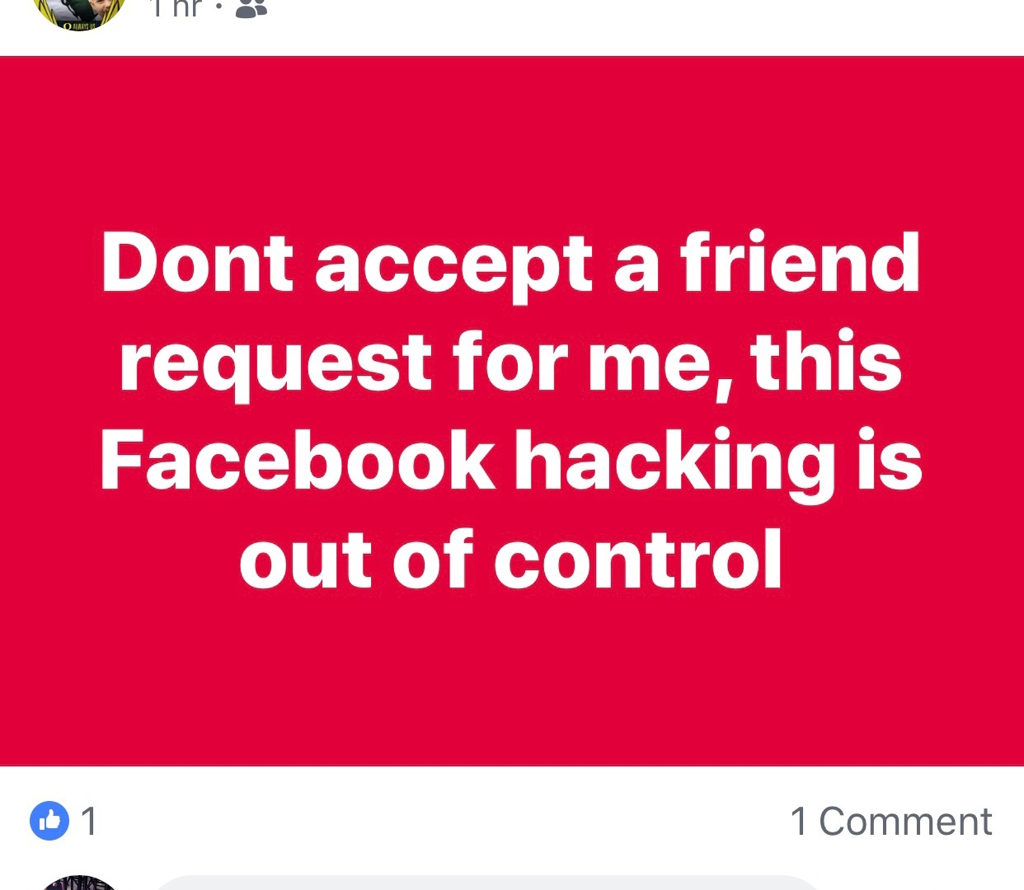
Facebook
But were you really?

Slide 24
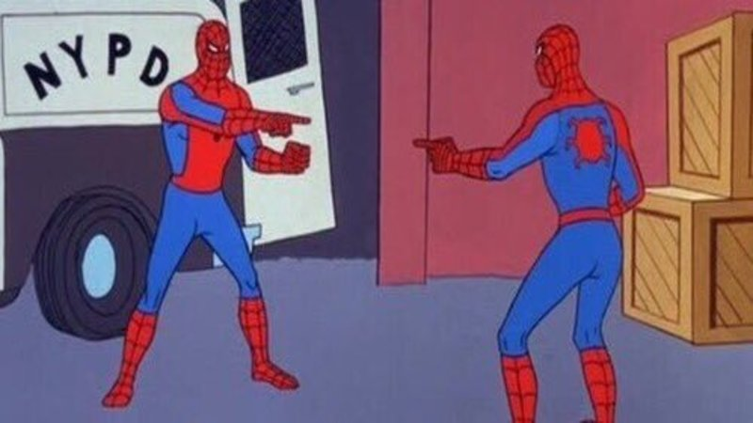
Facebook Hacked vs Spoofed
FB Hacked – someone takes over your account
FB Spoofed – A new account using your name/picture
Notes:
One of the easier ways to explain the difference between hacked versus spoofed/impersonation is looking at Spiderman. On the left, we see Venom taking over Spiderman. This represents hacking. Hackers will manipulate their way into an account and take over that account. They may act like that individual or act irrationally, however, this can lead to friends and family identifying their may be a problem. When a hacker has this account, they will likely send malicious links or request money from friends/family.
Whereas spoofing/impersonation is two accounts that look similar to each other. The original account/spiderman (Tobey McGuire) likely has information that is not secured, which allows the impersonated account/2nd spiderman (Andrew Garfield) to take that information and use it to recreate the account. When the impersonator recreates the account, they will send friend requests. The impersonator may attempt to chat after a request is accepted before sending a malicious link or request money.

Slide 25
Spoofers/ Impersonators
Spoofers Don’t Have Your Password!
They’ve opened a new account, duplicated the photos on your page and put them on the new one, and they’ve copied your descriptions. It takes literally just a few minutes to do.
They will use your public friends list to ask for money

Slide 26
How to React?
Reporting a spoofed profile
To report a spoofed profile, go to the scammer’s Facebook page and then use the dropdown to the far right of the Message button on the cover photo (click on the three dots). Select “Find Support or Report Profile” and then “Pretending to Be Someone.”
Protect yourself from being spoofed
The most important way to protect yourself from being spoofed is to make your friends list private. Go to Settings, then Privacy, and then review the question “Who can see your friends list?” This should NOT be set to “Public.”
Notes:
https://www.kallmaker.com/difference-hacking-spoofing-on-facebook/

Slide 27
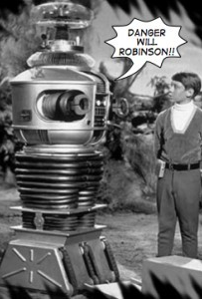
Hacked
Hacking on Facebook means someone has your password. They are inside your account, and they can do anything with your account that you can do.
THIS IS A SECURITY EMERGENCY, especially if you’ve used that password on other accounts or you have set up any kind of payment system with Facebook, or used Facebook’s authentication to log into other accounts.
Go to Facebook’s Hacked Accounts Help, immediately. Follow the directions. Change your passwords everywhere, especially email, banking and credit card accounts. Keep an eye on your credit card transactions posted by your bank.

Slide 28
How to Protect Yourself
If you want to make your Facebook account less desirable to spoofers, consider making your Friends List private.
Two-factor authentication (2FA) is the most important measure you can put in place to avoid being hacked. If you haven’t already put it in place, stop what you’re doing and do it now! It only takes a few clicks and could save you a whole lot of heartache. 2FA can be enabled in your Facebook’s Security and Settings configuration

Slide 29
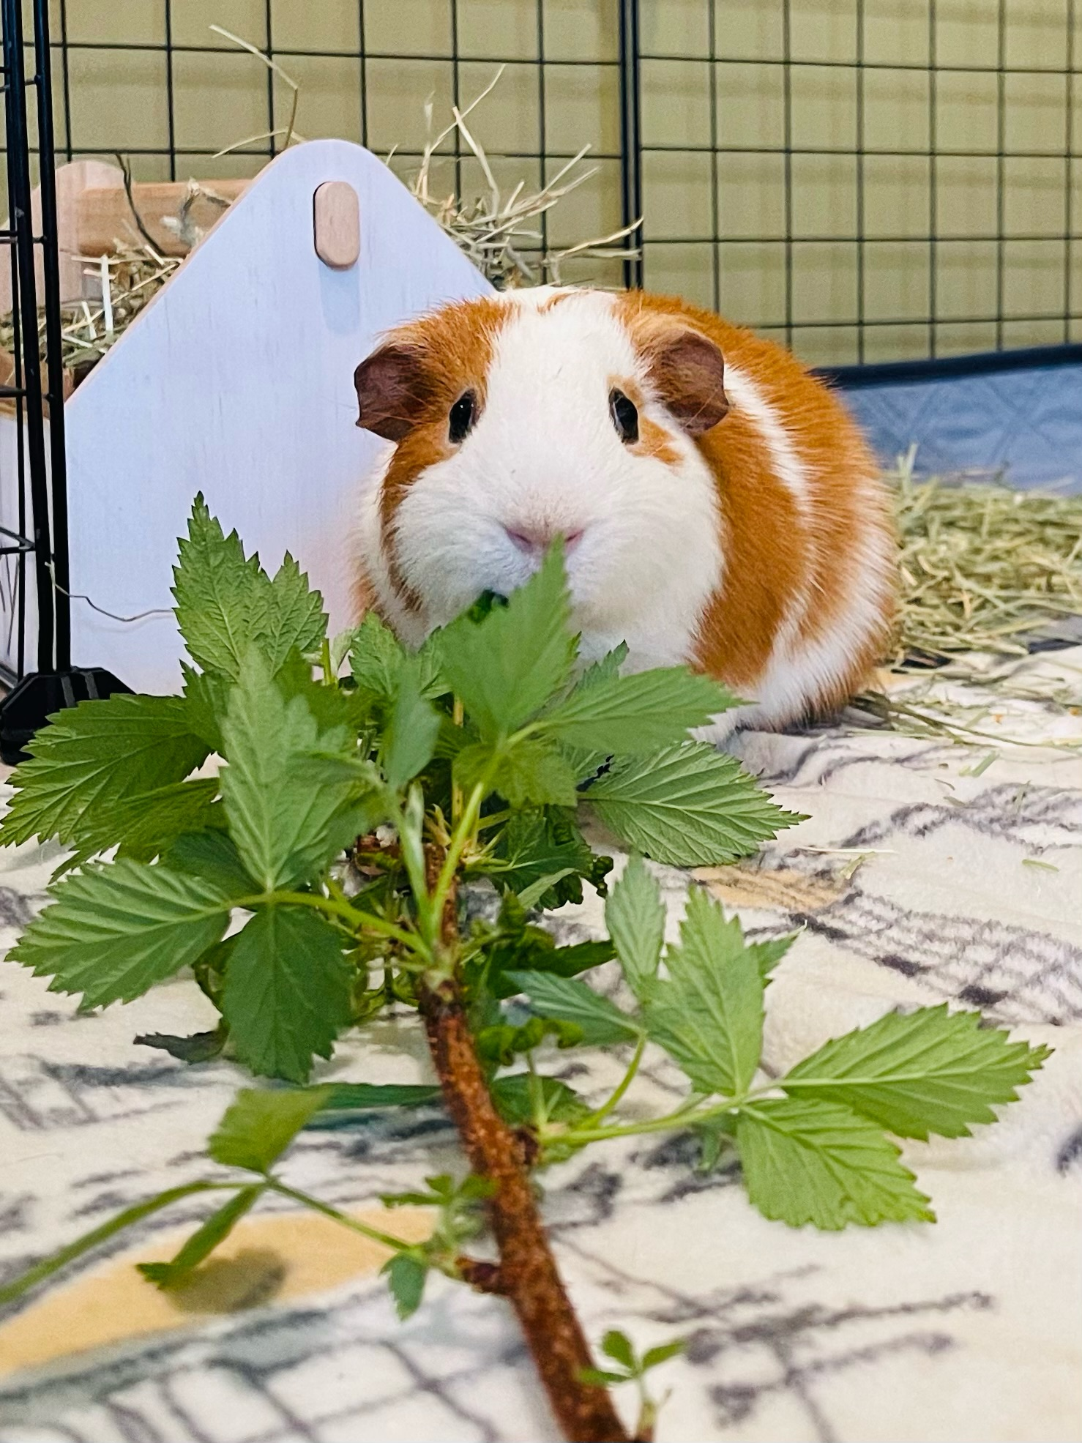
Tchai’s Final Thought:
Fresh Rasberry twigs anyone?

