Slide 1
Simultaneous Determination of Additive Concentration in Rubber using ATR-FTIR Spectroscopy
Stephen Merrimanª, Dinesh Chandra^{b}, Marc Borowczak^{b}, Ali Dhinojwalaª, David Benko^{b}
ª
^{b}
School of Polymer Science and Polymer Engineering
Notes:
30 talk total

Slide 2
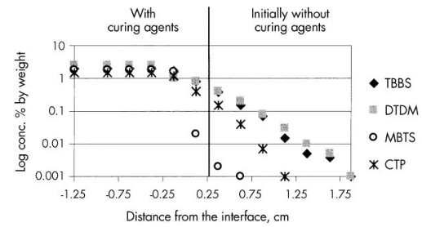
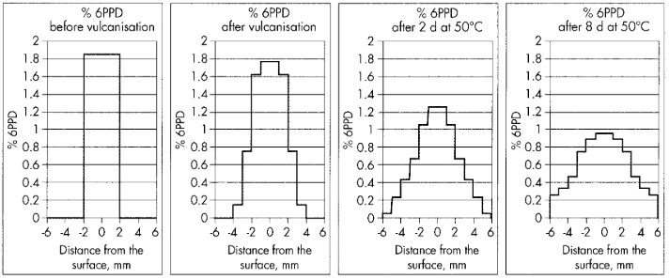
Motivation
Tracking additives (curing agents, antioxidants, antiozonants, etc.) between rubber compounds and throughout a tire is necessary to assess and optimize performance.
Experimentally monitoring additive concentrations is difficult and time consuming.
Component isolation and extraction.
Preferred method:
Measure additive concentrations directly on rubber.
Anthoine, B.H.; Ignatz-Hoover, T. Int. Polym. Sci. Technol. 32 (11) 1-13

Slide 3
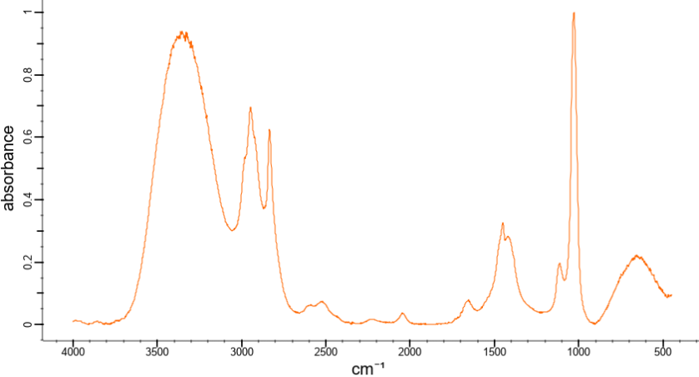
Attenuated Total Reflectance (ATR) Infrared (IR) Spectroscopy
Detector
Methanol
IR Light Input
IR Light Output
Conventional / Transmission FT-IR Spectroscopy
Sample
Attenuated Total Reflectance (ATR) FT-IR Spectroscopy
Sample
IR Light Input
Detector
Crystal
Spectral Database. https://spectrabase.com/spectrum/3gHGPFgWrKC
Spectral Database. https://spectrabase.com/spectrum/3gHGPFgWrKC
https:/bruker.com

Slide 4
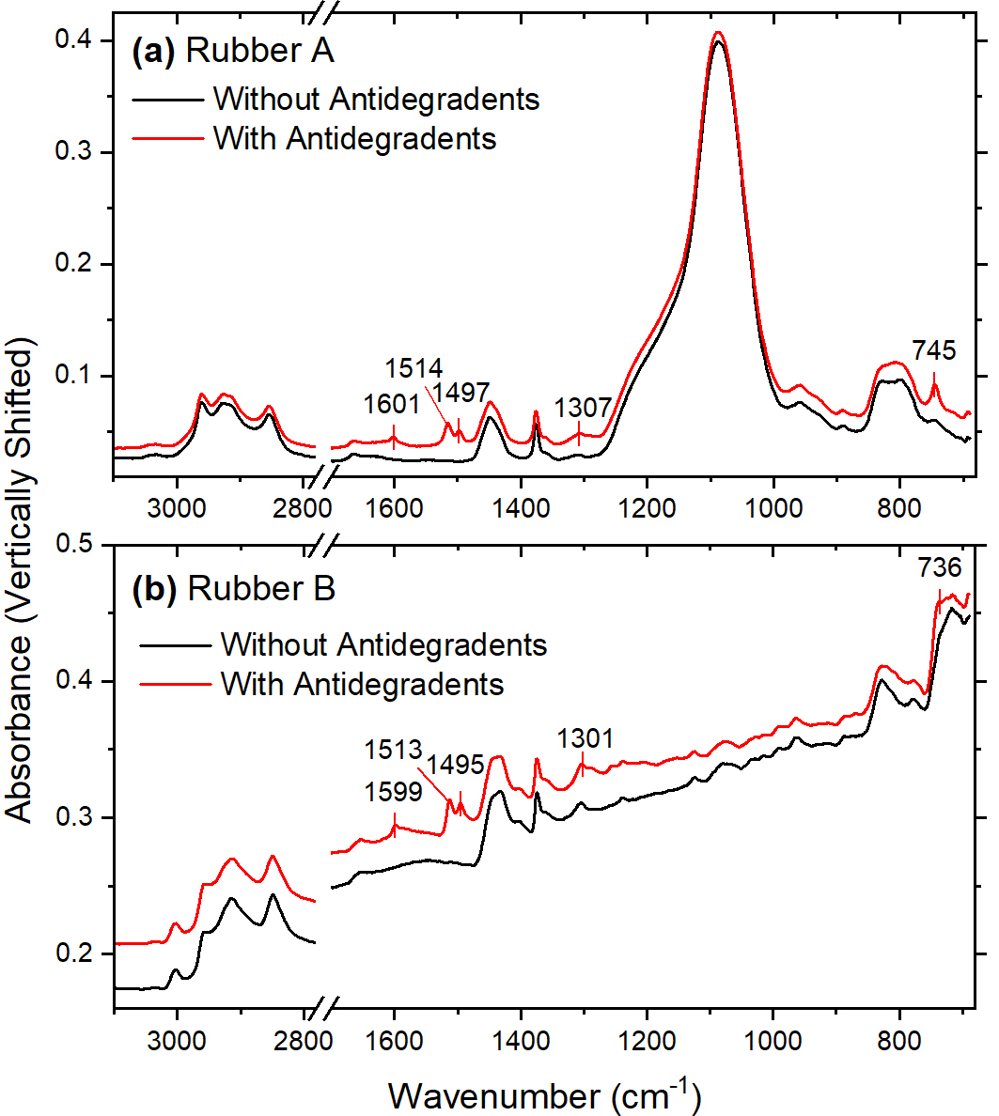
Quantification using ATR spectroscopy
Considering three antioxidants/antiozonants (“antidegradents”) of similar chemical structure.
Rubber A (Silica filled NR)
Rubber B (C-black filled NR:PBD blend)
Molar absorptivity
Absorbance
Pathlength
Concentration
Beer’s law:
$$A= ε ×l ×c$$
$$=k×c$$
Merriman, S. et al. Spectrochim. Acta A Mol. Biomol. 281 (121614)

Slide 5
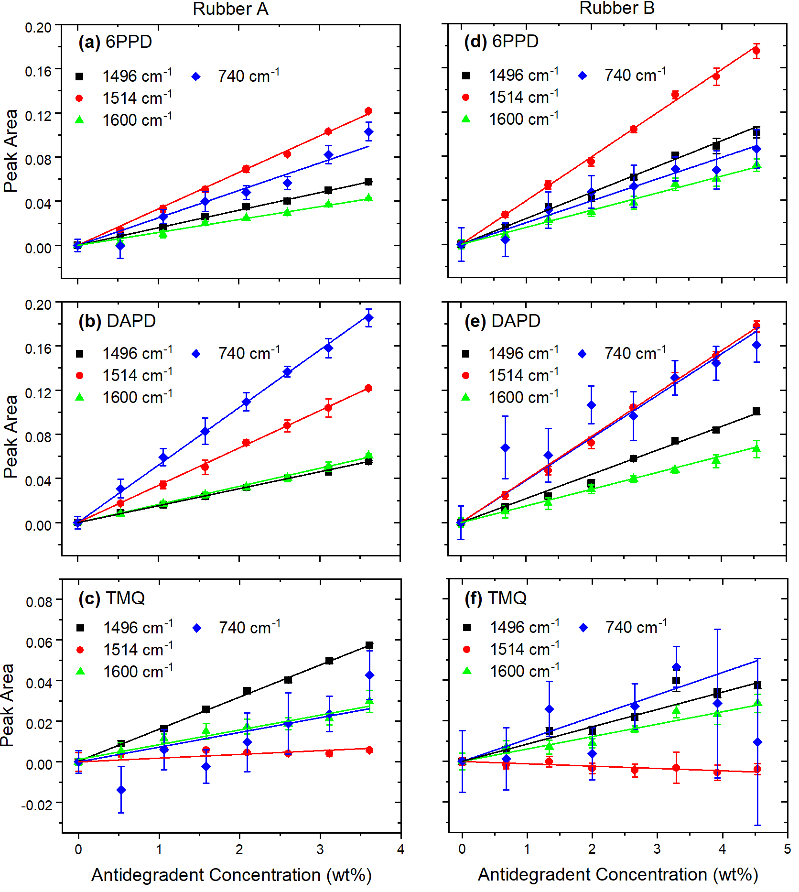
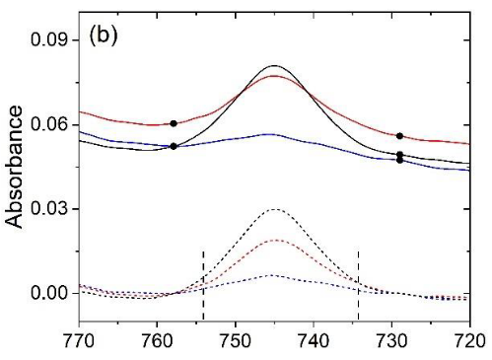
Beer’s Law Validation
Rubber A (Silica filled NR)
Rubber B (C-black filled NR:PBD blend)
Antidegradent absorbance closely matches Beer’s law
Baseline
Integration
Baseline
Merriman, S. et al. Spectrochim. Acta A Mol. Biomol. 281 (121614)

Slide 6
Classical Least Squares Analysis
Rubber A (Silica filled NR)
Rubber B (C-black filled NR:PBD blend)
Beer’s law:
One component
Beer’s law:
$i$ components
$$A=k×c$$
$$A=\sum_{i}{k×c}$$
Peak 1:
$$A_{1}=k_{1,1}c_{1}+k_{1,2}c_{2}+k_{1,3}c_{3}$$
Peak 2:
$$A_{2}=k_{2,1}c_{1}+k_{2,2}c_{2}+k_{2,3}c_{3}$$
Peak 3:
$$A_{3}=k_{3,1}c_{1}+k_{3,2}c_{2}+k_{3,3}c_{3}$$
Only total antidegradent concentration can be determined.
Merriman, S. et al. Spectrochim. Acta A Mol. Biomol. 281 (121614)

Slide 7
Partial Least Squares Analysis
Partial least squares (PLS) multivariate statistical approach:
Consider the absorbance at every wavenumber within defined spectral regions (lots of data points!) rather than 3 discrete peak areas.
Construct a predictive model taking into account each point.
Well suited for analysis of spectral data.
Each antidegradent can be individually quantified to ~0.15 wt%
Merriman, S. et al. Spectrochim. Acta A Mol. Biomol. 281 (121614)

Slide 8
Conclusions
Antidegradent IR absorbance in rubber closely follows Beer’s law for 0-~4.5wt% (0-7 PHR).
Classical least squares (3-peak area) quantification method predicts total antidegradent wt%, but not individual concentrations.
Partial least squares (PLS) quantification method predicts each antidegradent individually to within ~0.15 wt%.
Takeaways
Chemical quantification directly on fully formulated rubber using IR absorption spectra is possible.
The method demonstrated could be extended to other additives and/or other systems and could be used to track migration, blooming, reactions, etc.
Compared to traditional methods, IR spectra collection is direct, non-destructive, spatially-resolved, and rapid.
Full details of the project:
https://doi.org/10.1016/j.saa.2022.121614

Slide 9
Questions

Slide 10
Supplemental Slides

Slide 11
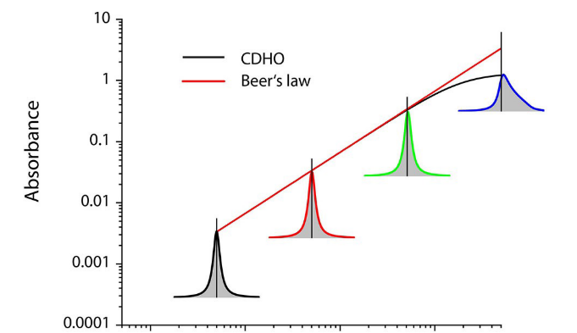
Problems with IR absorption-based quantification
Antidegradents of similar chemical structure show similar spectral signatures and overlapping peaks.
Beer’s law is highly idealized: not applicable in general to all systems.
Especially true for larger absorbance and samples with non-homogenous optical properties (i.e., complex refractive index).
Mayerhöfer, T. G., et al. ChemPhysChem 2016, 17, 1-9.
Mayerhöfer, T. G., et al. ChemPhysChem 2020, 21, 2029-2046.
Concentration
Merriman, S. et al. Spectrochim. Acta A Mol. Biomol. 281 (121614)

Slide 12
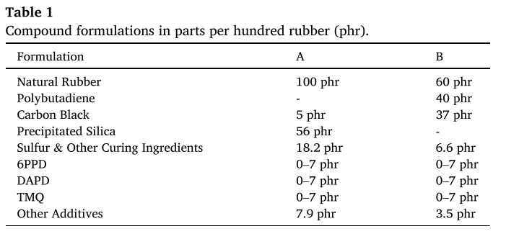
Rubber Formulations

