Slide 1



Ohio Rubber Group
Spring Technical Meeting 2022
Bioinspired Material Design from
3D Printed Rubber
Arnob Banik
PhD Candidate
Mechanical Engineering Department
The University of Akron
Advisor - Dr. KT Tan
Advanced Metacomposites Laboratory
April 12, 2022

Slide 2
Content
3 Parts
Part 1
Bioinspired Surface Design
Part 2
Bioinspired Shell Structure
Part 3
Bioinspired Composite for Low Temperature Condition
Application of 3D Printed Rubber Materials

Slide 3
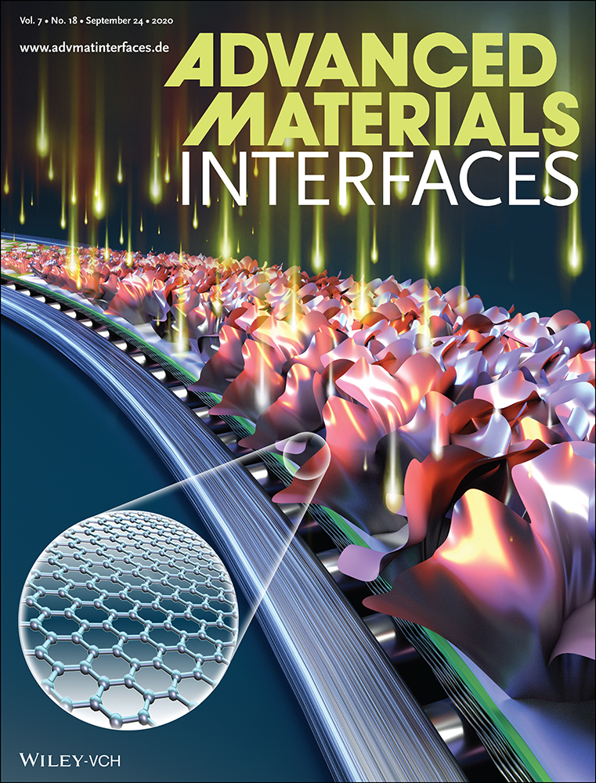
Part 1 – Bioinspired Surface Design
Part 1
Bioinspired Surface Design
Part 2
Bioinspired Shell Structure
Part 3
Bioinspired Composite for Low Temperature Condition
Dynamic Friction Performance of Hierarchical Biomimetic Surface Pattern Inspired by Frog Toe-Pad
Banik, A., and Tan, K.T. (2020). Dynamic Friction Performance of Hierarchical Biomimetic Surface Pattern Inspired by Frog Toe‐Pad. Advanced Materials Interfaces, 7, 2000987

Slide 4
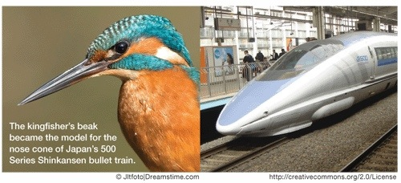
Biomimicry
  Biomimicry is a design technique that adapts nature’s solutions to be used to solve human problems in engineering through mimicking biological models.
Kingfisher inspired Bullet Train
Using shape to reduce noise level from Tunnel Boom
Part 1- Bioinspired Surface Design

Slide 5
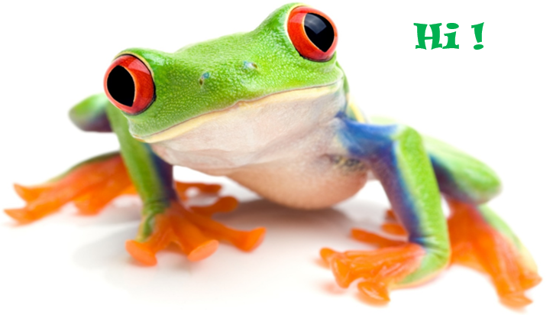
Motivation
THINKING !!!
How can we use any microstructure or shape from the biomimetic field to improve tire’s wet friction performance?
Why?
  Toe pad shape
Part 1- Bioinspired Surface Design

Slide 6
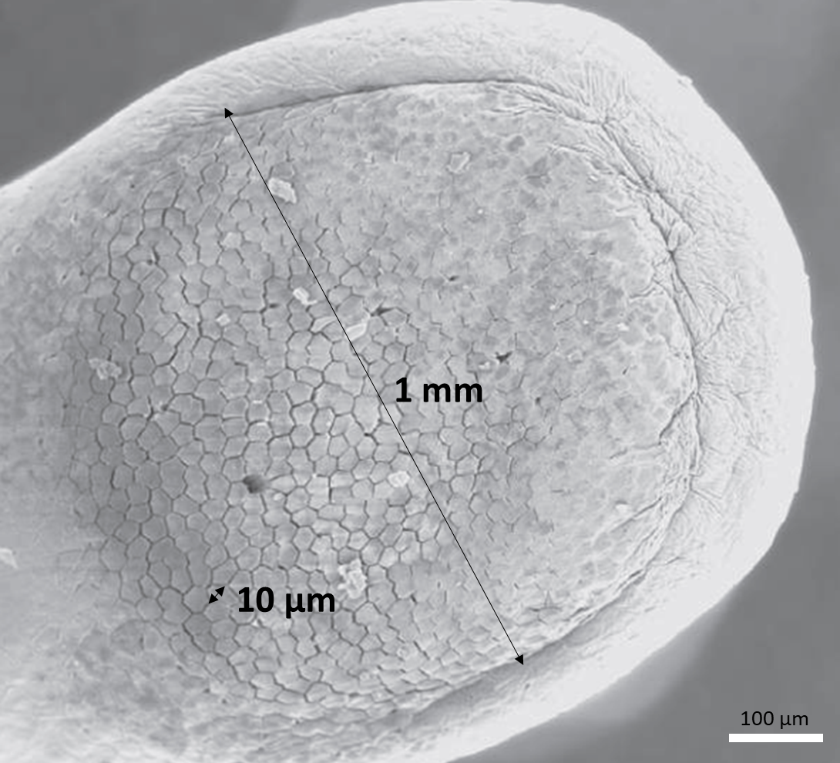
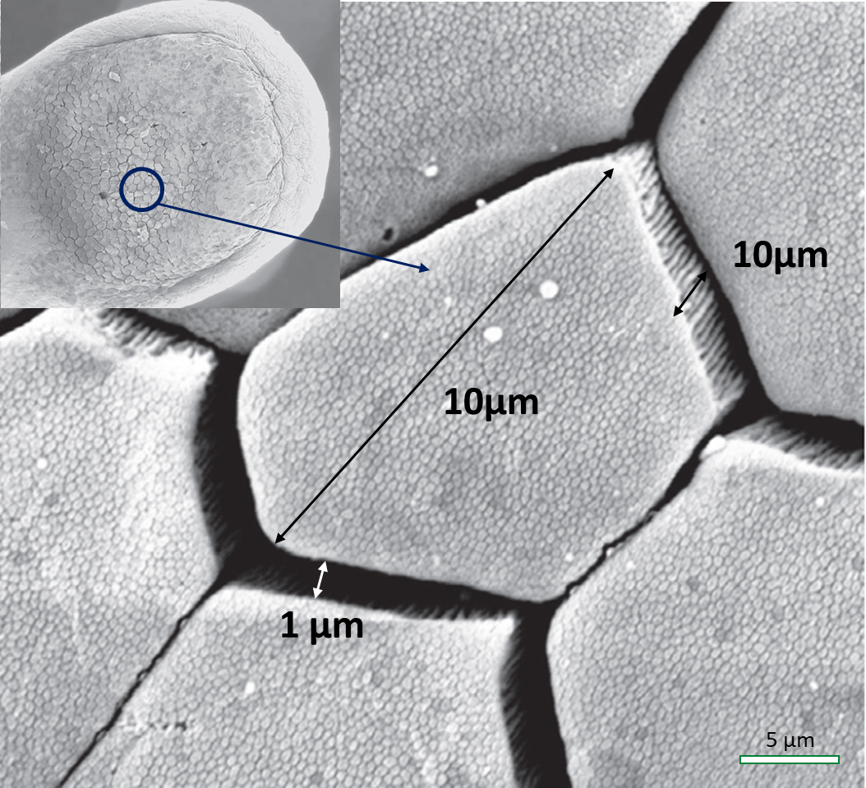
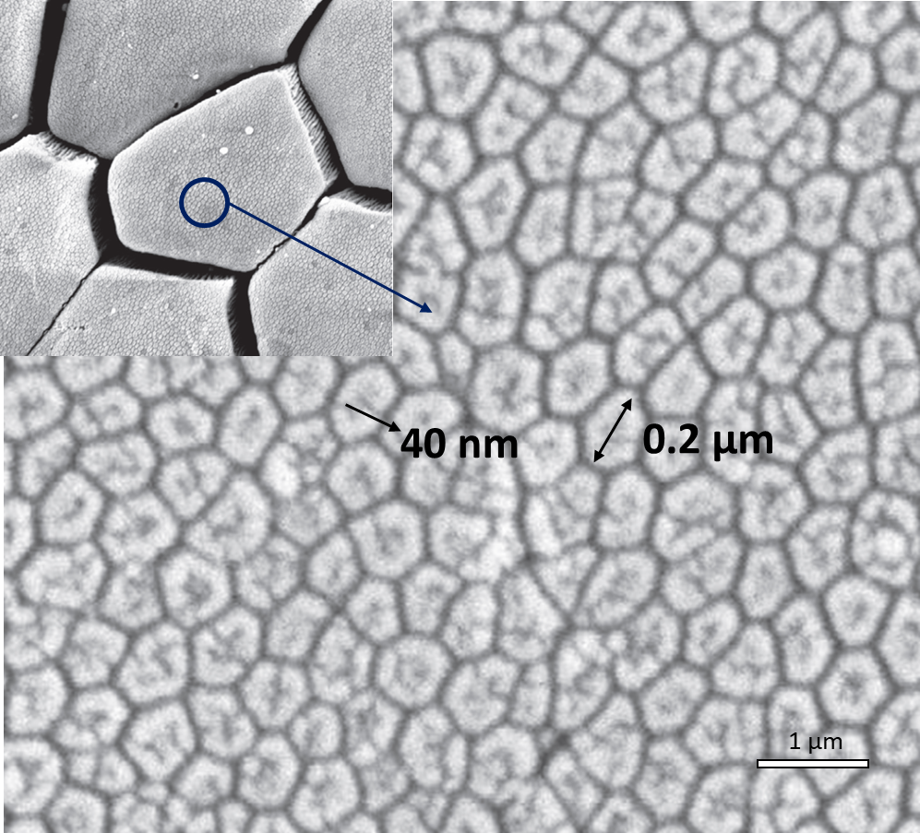
Motivation
Frog Toe Pad
Tree frog toe pad (Litoria caerulea).
The diameter of the toe pad is of order ∼1 mm.
The hexagonal array of cells or blocks, separated by grooves or channels.
The diameter of one hexagonal block is of order ∼10 µm
High magnification view of the surface of a single hexagonal cell showing peg-like projections
Grooves or channels
Peg-like projections
Persson, B. N. J. Wet adhesion with application to tree frog adhesive toe pads and tires. J. Phys. Condens. Matter 19, 376110 (2007).
Part 1- Bioinspired Surface Design

Slide 7
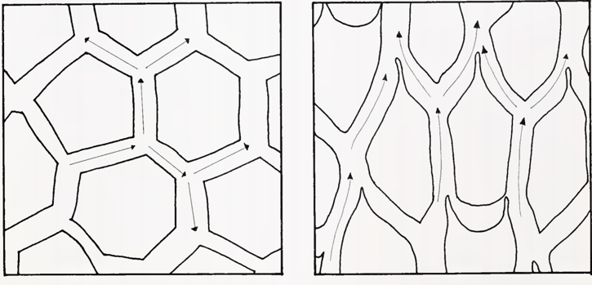
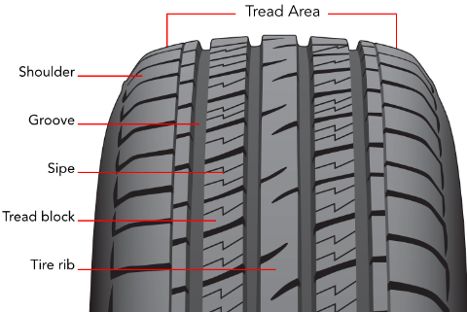
Motivation
Analogy Between Toe Pad and Tire Tread Block
Scheme of liquid fluid of a digital pad with regular out shaped cells (left) and with elongate cells (right)
Annemarie Ohler. Digital Pad Morphology in Torrent-Living Ranid Frogs. Asiatic Herpetological Research 1995; 6: 85-96
Tire Tread Block
https://www.discounttire.com/learn/tire-construction
7
Part 1- Bioinspired Surface Design

Slide 8
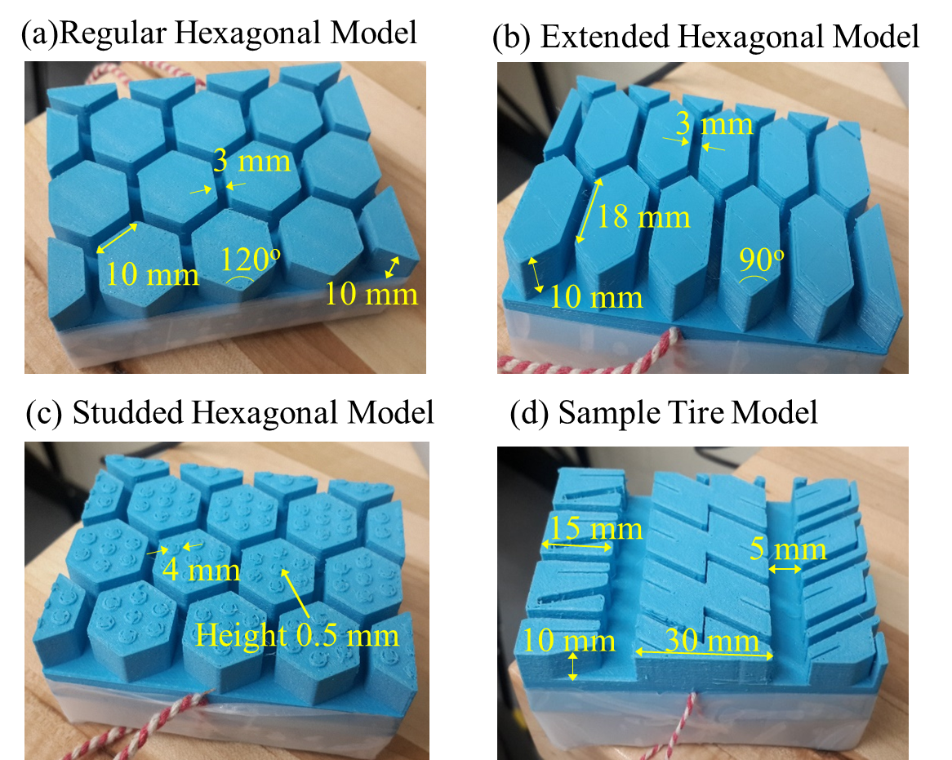
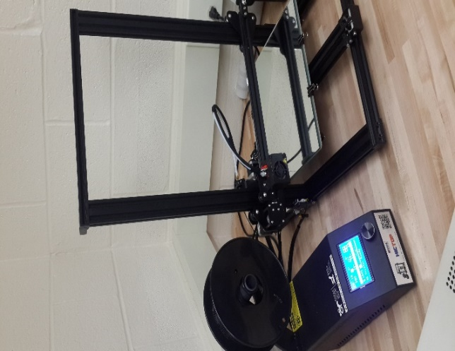
Materials and Models
AIM - Develop a unique, creative and feasible design in rubber surface mimicking frog toe pad to have better wet friction characteristics
Scheme of liquid fluid of a digital pad with regular out shaped cells (left) and with elongate cells (right)
Annemarie Ohler. Digital Pad Morphology in Torrent-Living Ranid Frogs. Asiatic Herpetological Research 1995; 6: 85-96
Creality CR-10 (3D Printer)
80mm × 60mm × 20mm
Thermoplastic Polyurethane (TPU)
Part 1- Bioinspired Surface Design

Slide 9
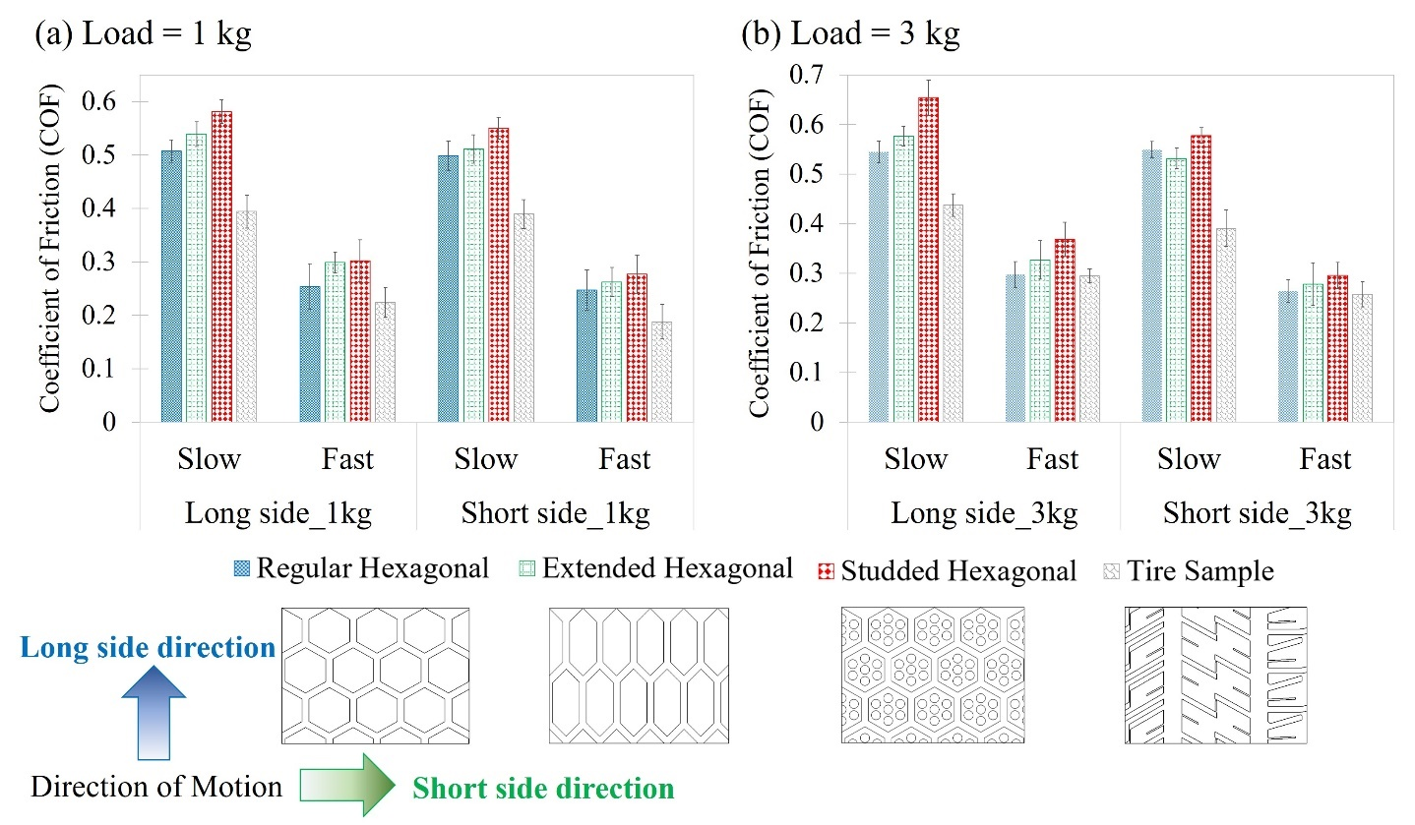
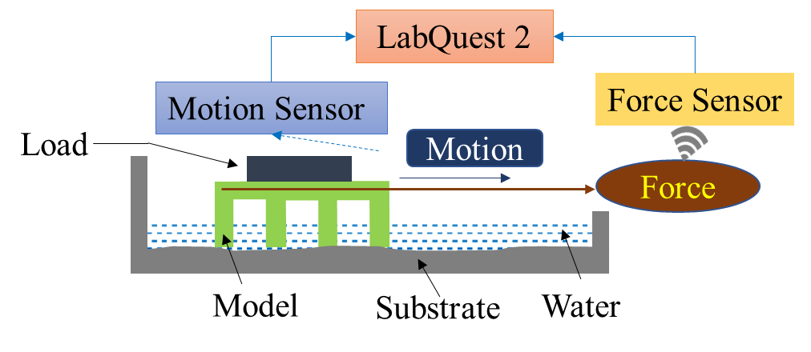
Experiment - Result
Coefficient of friction (COF) determination
Higher COF from Studded Hexagonal Model
Load ; Velocity; Direction
Part 1- Bioinspired Surface Design

Slide 10
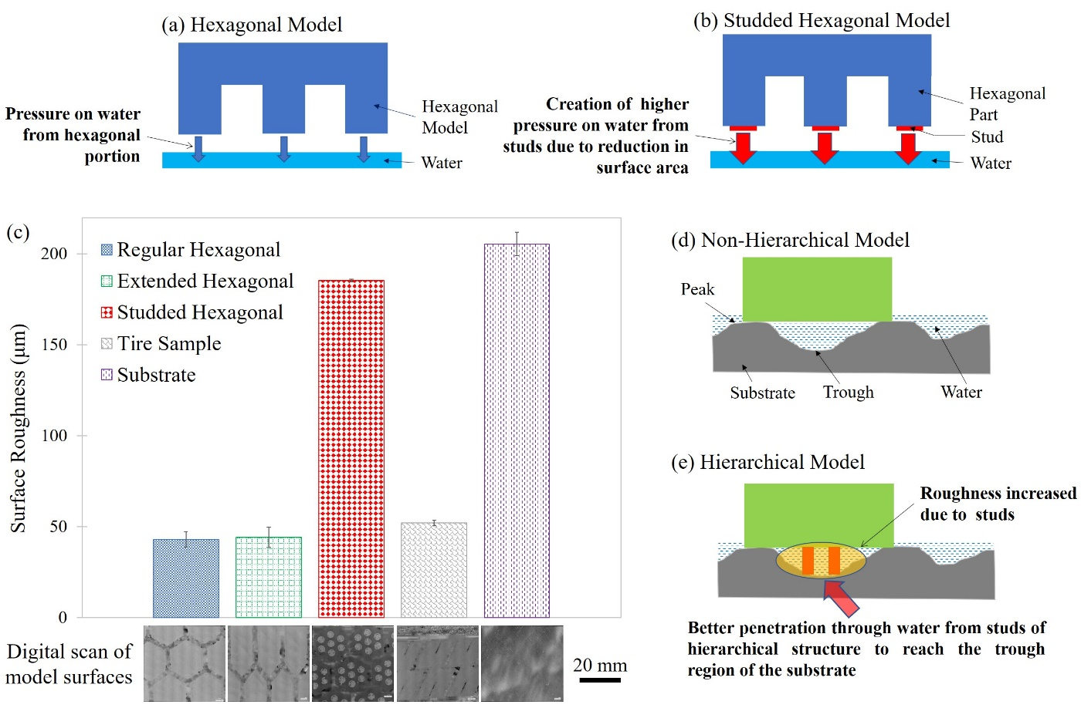
Experiment - Result
The existence of water layer between two solid surfaces adversely affects the COF
Increased pressure through the reduction in contact area
Surface roughness in the form of studs contributed to maximize exposure of dry surface, minimize water height
  Attributed to improving the hydrophobicity
Increased wet adhesion due to reduction in trapped water height
  Capillarity and Stefan adhesion.
Part 1- Bioinspired Surface Design

Slide 11
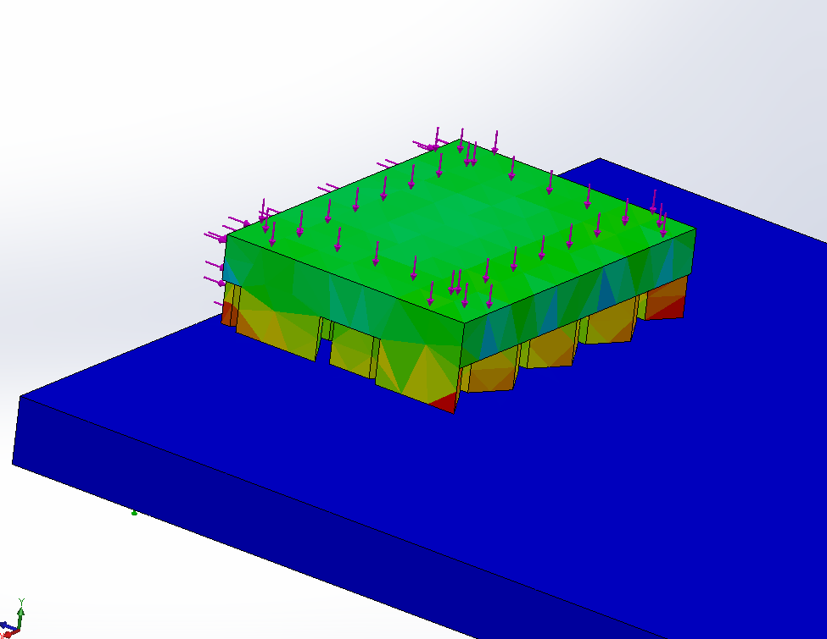
Simulation – Static Structural Analysis
FEA analysis from ANSYS
  Friction Coefficient
    0.2-0.6
  Material
    Model : Rubber
    Surface : Concrete
  Force
    Top : 10N
    Behind : 1N
  Fixed
    Base of the surface
Rubber
10N
1 N
Concrete
Fixed
Part 1- Bioinspired Surface Design

Slide 12
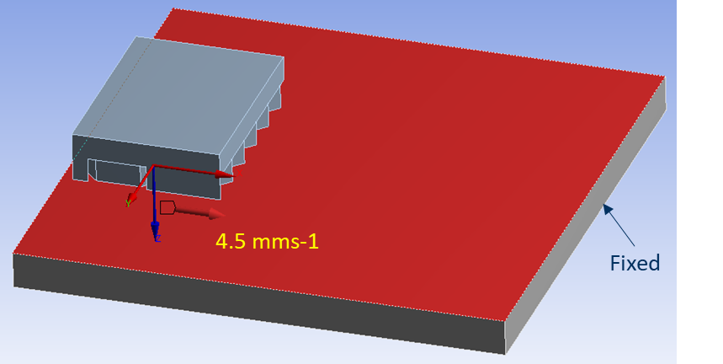
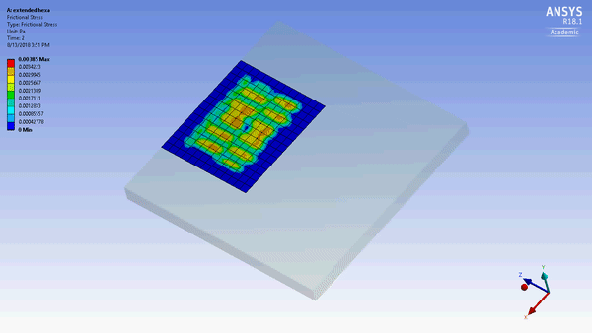
Simulation – Transient Structural Analysis
Parameters:
  Friction Coefficient:
    0.2-0.6
  Material :
    Model : Rubber
    Surface : Concrete
  Velocity :
    4.5 mms-1
  Fixed:
    Base of the surface
4.5 mms-1
Part 1- Bioinspired Surface Design

Slide 13
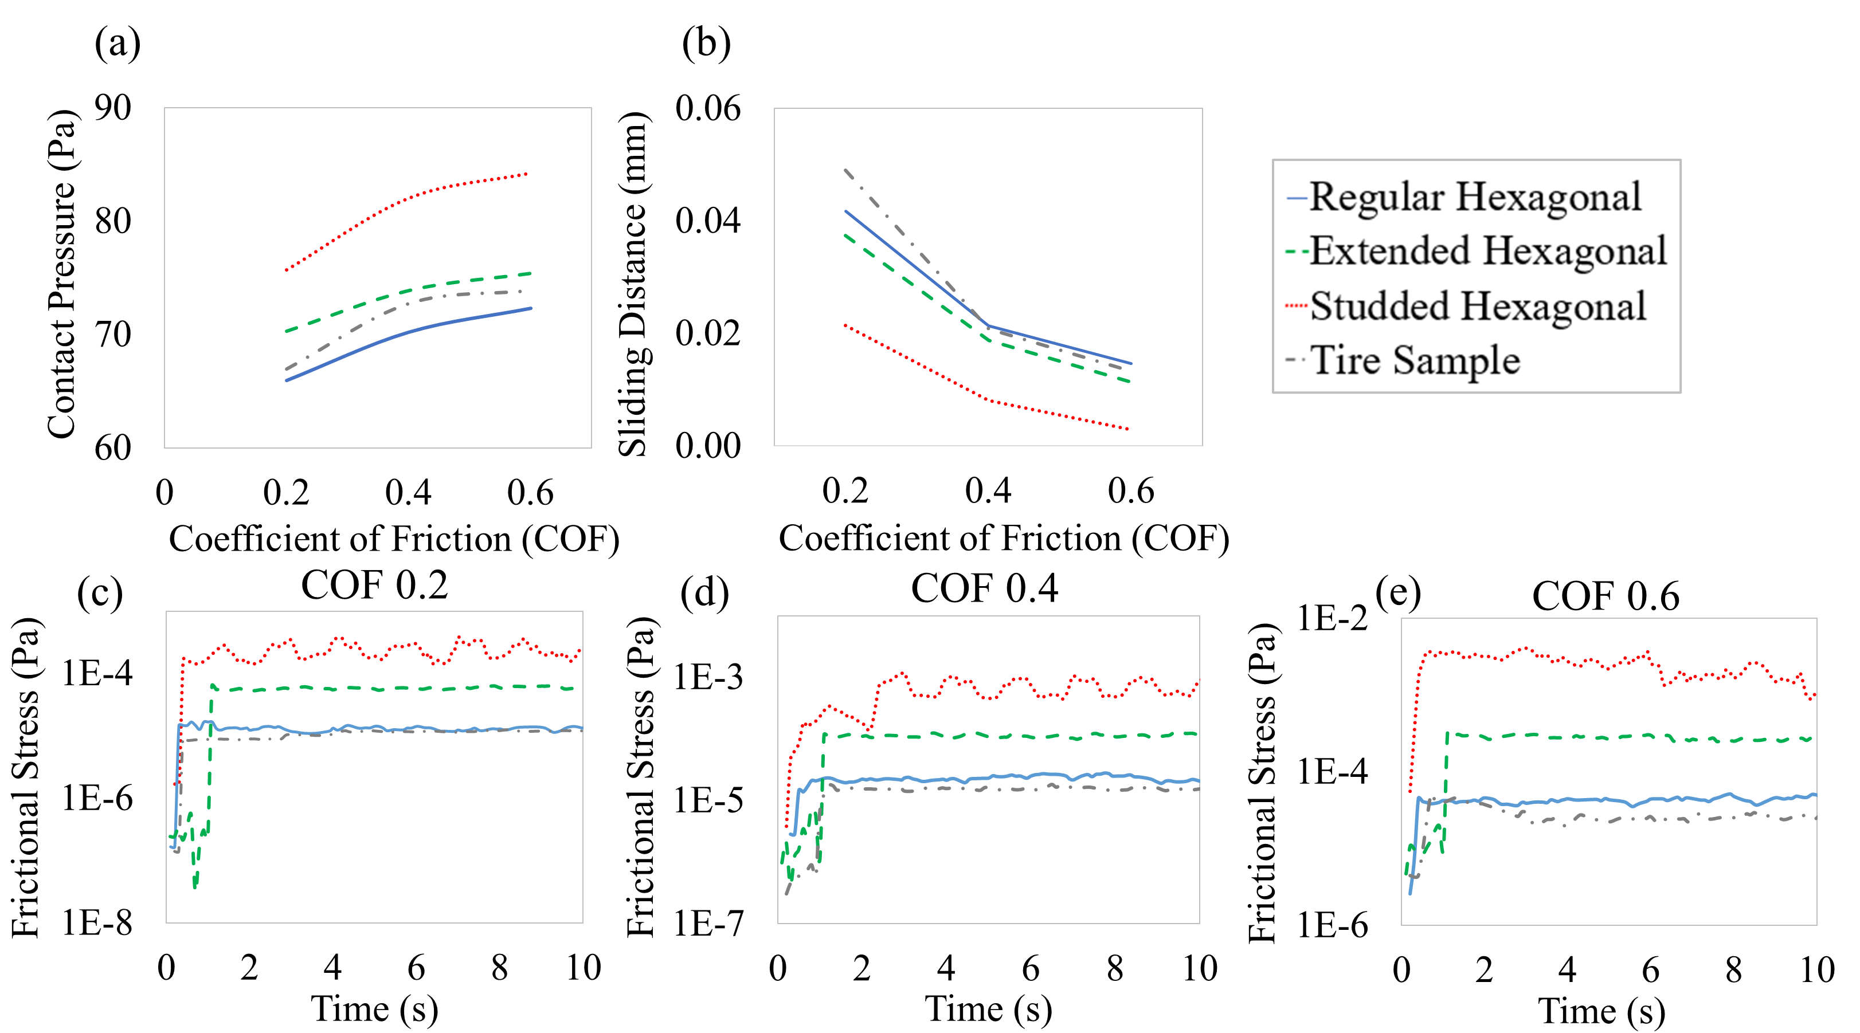
Results - Simulation
Studded hexagonal model
  Higher surface contact pressure
  Less sliding displacement
  Higher frictional stress
  Intermittent rise and drop more prominent than other models.
  Demonstrates the greater resistive behavior during motion.
ANALYTICAL APPROACH - Water squeeze out time and height
Part 1- Bioinspired Surface Design

Slide 14
Conclusion
Double-layered studded hexagonal surface pattern exhibited the best friction performance under wet conditions compared to other hexagonal and tire models.
Increased pressure and surface roughness in the form of studs contributed to maximize exposure of dry surface, minimize water height
  Increment in the surface roughness attributed to improving the hydrophobicity as well as capillarity and Stefan adhesion.
2nd Place, Monte Jade Innovation Competition (Future Tire) 2018
John Harvey Pressure Vessel Scholarship 2019
Part 1- Bioinspired Surface Design

Slide 15

Part 2 – Bioinspired Shell Structure
Part 1
Bioinspired Surface Design
Part 2
Bioinspired Shell Structure
Part 3
Bioinspired Composite for Low Temperature Condition
Impact Tolerance and Compressive Behavior of Biomimetic 3D Printed Sea Urchin Shell Structures
Doong, K., Banik, A., Kaiser, I., Zhang, C., and Tan, K.T. (2022Impact Tolerance and Compressive Behavior of Biomimetic 3D Printed Sea Urchin Shell Structures
Polymers (under 2nd round of revision)

Slide 16
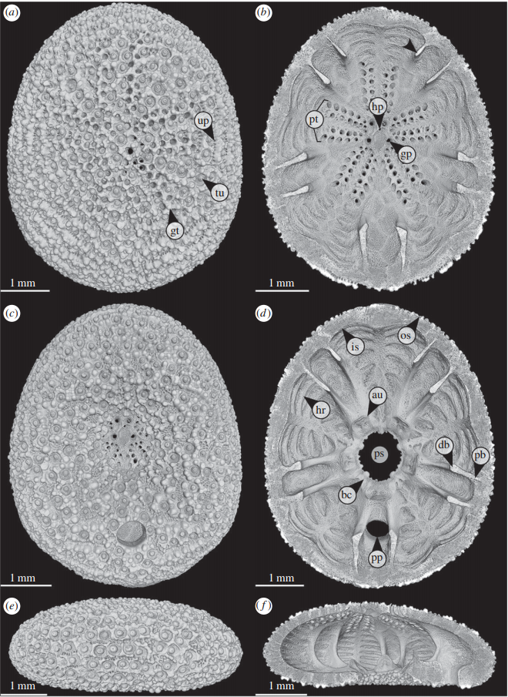
Sea Urchin
  Spiny marine invertebrate animals with a globular body and a radial arrangement of organs
    950 living species
  Skeletal structural design with excellent strength
    Dome Shape
    Internal supports
    Skeletal interlocks
  Sustain up to 5000m depth of ocean
  Tropical to polar region
Model: Echinocyamus pusillus
Potential Applications
  Architectures exposed to dynamic impact loading
  High-pressure structures in deep-sea exploration
  Even landing gears for space exploration.
Echinocyamus pusillus.Micro-CT based volume rendering of the denuded test
GrunTB, Nebelsick JH. 2018 Structural design of the minute clypeasteroid echinoid Echinocyamus pusillus. R.Soc. Open sci. 5: 171323
Part 2- Bioinspired Shell Structure

Slide 17
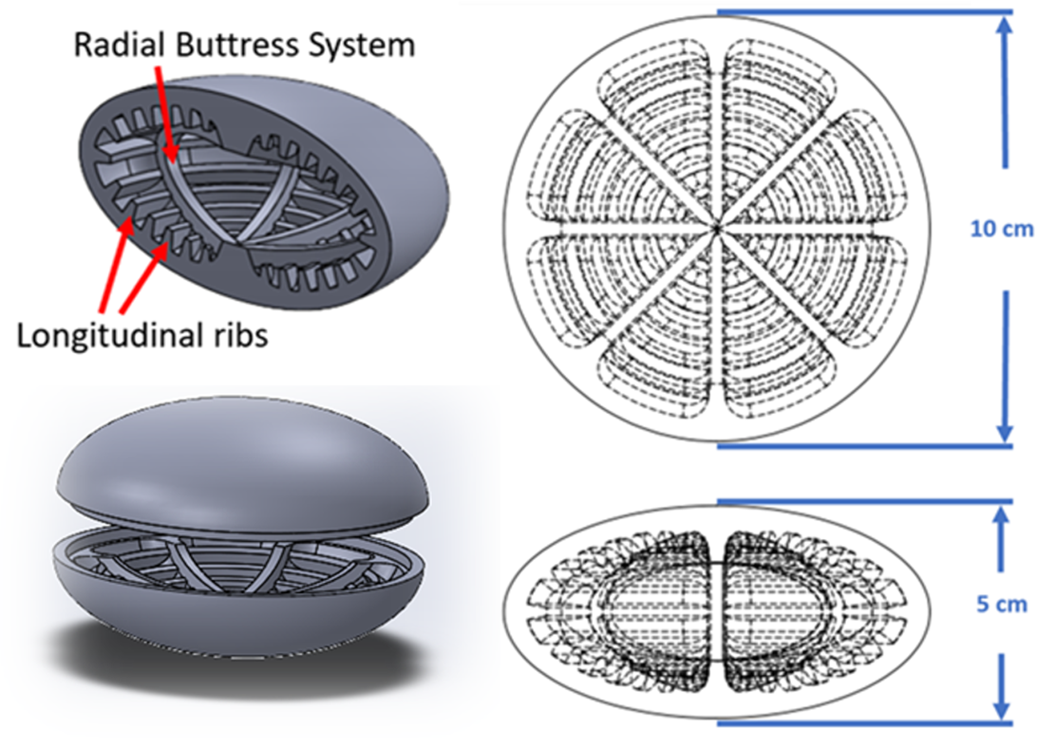
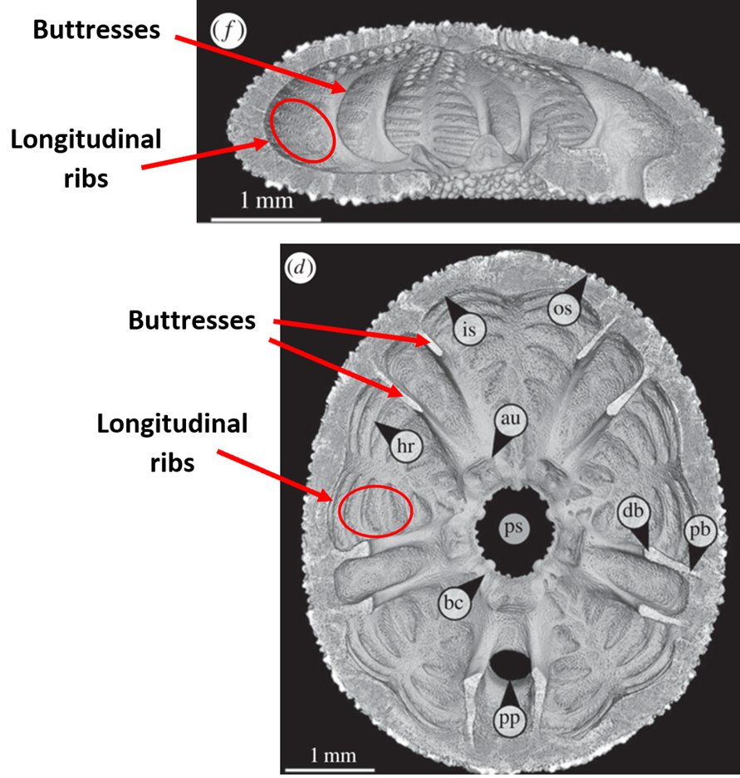
Material and Model
AIM - Examine the impact tolerance of unique sea-urchin inspired models varying thickness, number of buttress and spacing type.
Ellipse shape
Rectangular internal supports
  Buttress – 0, 4 or 8
  Thickness - 2 mm and 3 mm
  Spacing – Even or Uneven
10 configurations
Material: TangoPlus FLX930
3D Printing Machine
  Stratasys Objet260 Connex3
  Buttress – 8
  Thickness - 2 mm
  Spacing – Even
  Buttress – 8
  Thickness - 2 mm
  Spacing – Uneven
μCT (micro-computed tomography) [1]
[1] Grun TB, Nebelsick JH. 2018 Structural design of the minute clypeasteroidechinoid Echinocyamus pusillus.R. Soc. open sci.5: 171323.http://dx.doi.org/10.1098/rsos.171323
Part 2- Bioinspired Shell Structure

Slide 18
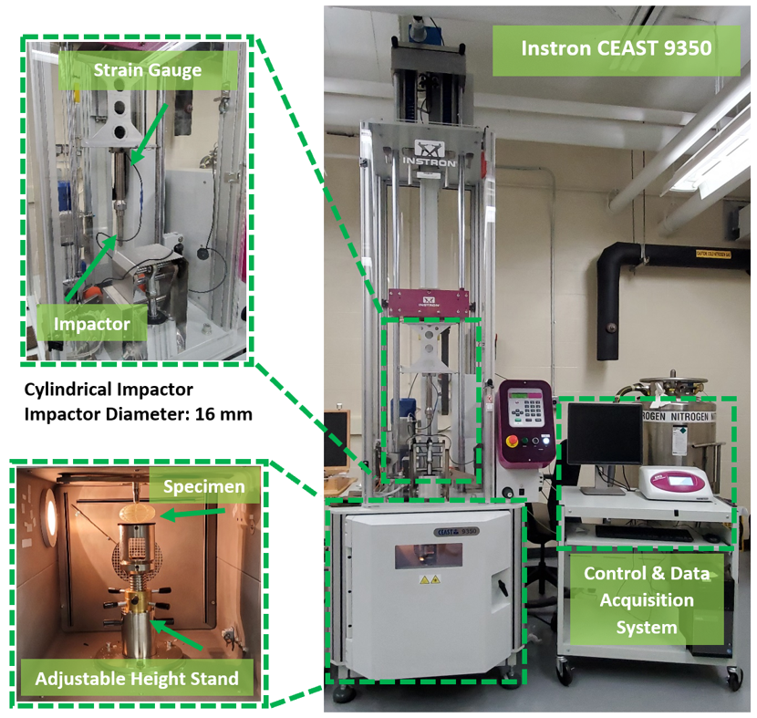
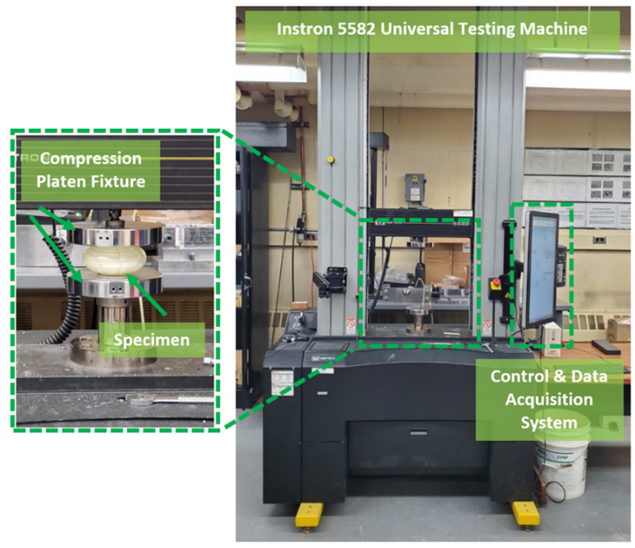
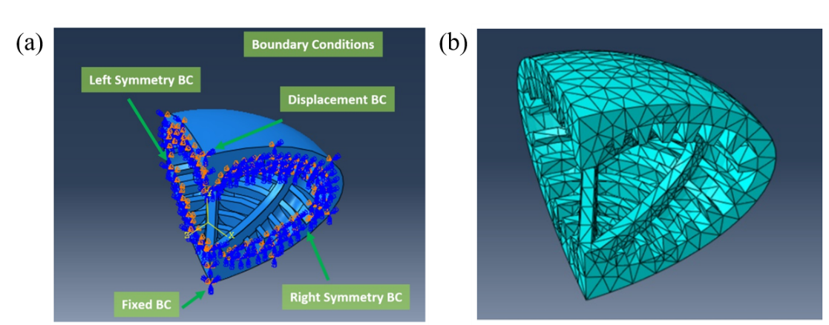
Experiment and Simulation
Impact Testing
5 J, 10 J, 20 J, and 40 J
Quasi Static Compression Testing
5 mm/min ; 10kN load cell
FEA Analysis
Part 2- Bioinspired Shell Structure

Slide 19
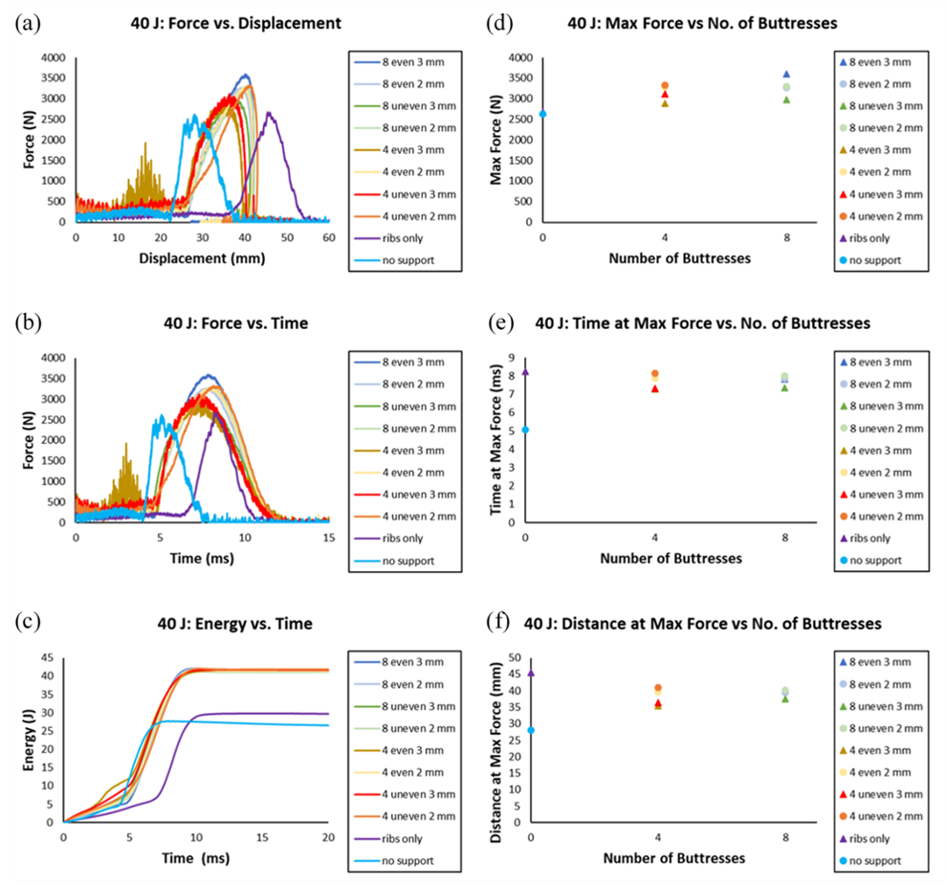
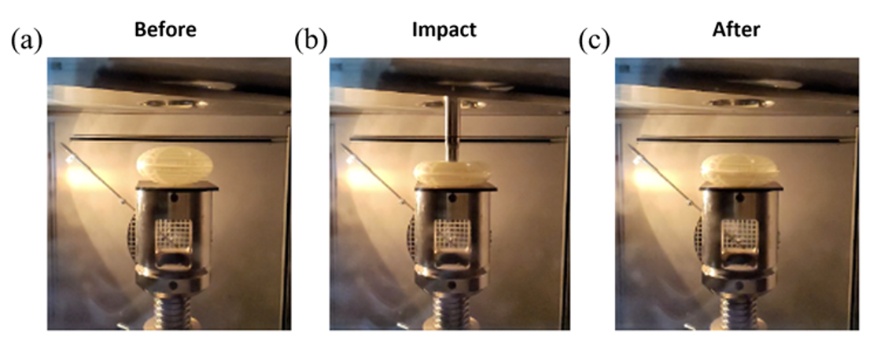
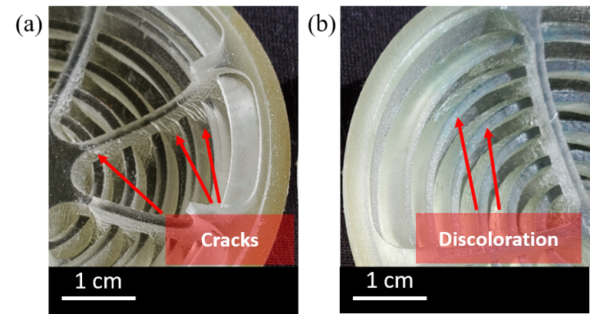
Experiment - Result
Impact testing: (a) before impact; (b) during impact; (c) after impact
Images of damage after impact: (a) cracks; (b) discoloration.
No Rebound
Increasing the number of buttresses provides higher stiffness.
Part 2- Bioinspired Shell Structure

Slide 20
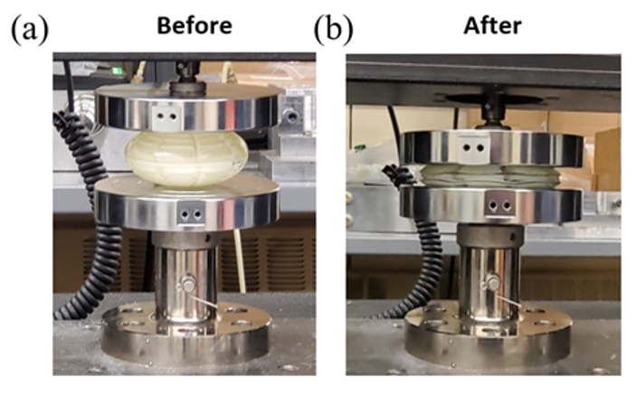
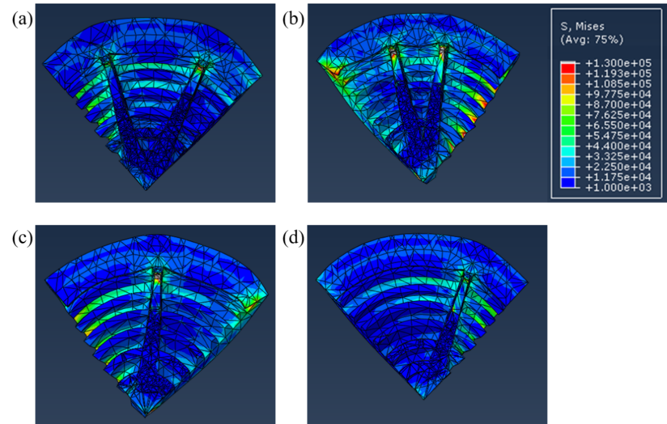
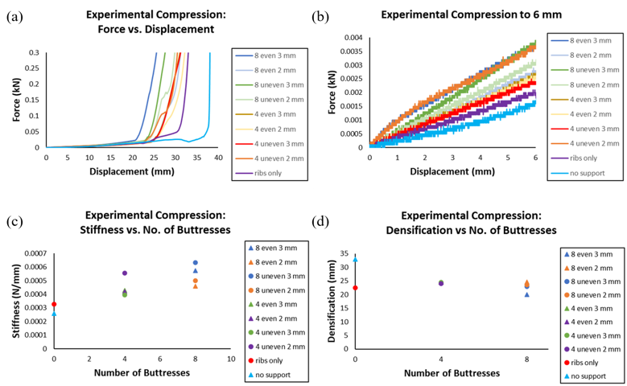
Experiment and Simulation - Result
Von Mises stress contour: (a) 8 even; (b) 8 uneven; (c) 4 even; (d) 4 uneven buttress specimens.
Higher stress levels for uneven spacing.
Increasing thickness of buttresses provides greater stiffness
Unevenly distributed paired buttresses possess high stiffness
Experimental compression testing
Part 2- Bioinspired Shell Structure

Slide 21
Conclusion
The skeletal strength of a sea urchin shell structure is achieved through internal supports (ribs and buttresses)
Impact testing - there is no rebound from 5 J to 40 J energy levels, which indicates that the structure absorbs all the impact energy
Experimental and FEA compression testing-
  Increasing the number of buttresses provides higher stiffness
  Unevenly distributed paired buttresses possess higher stiffness because a paired buttress acts like a single and thicker buttress.
Part 2- Bioinspired Shell Structure

Slide 22

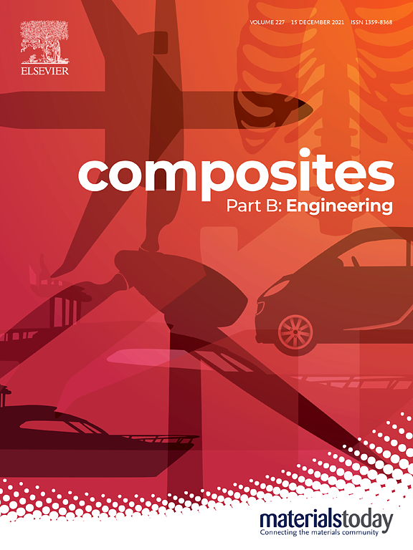
Part 3 – Bioinspired Composite
Part 1
Bioinspired Surface Design
Part 2
Bioinspired Shell Structure
Part 3
Bioinspired Composite for Low Temperature Condition
Banik, A., Zhang, C., Khan, M.H., Wilson, M., Tan, K.T. (2022). Low-Velocity Ice Impact Analysis on Steel and CFRP Specimen. International Journal of Impact Engineering, 162, 104134
Banik, A., Panyathong, D., Zhang, C., Tan, K.T. (2022). Equienergetic Low-Velocity Impact Performance Analysis on CFRP Specimen, Composites Part B: Engineering, 236, 109850.

Slide 23
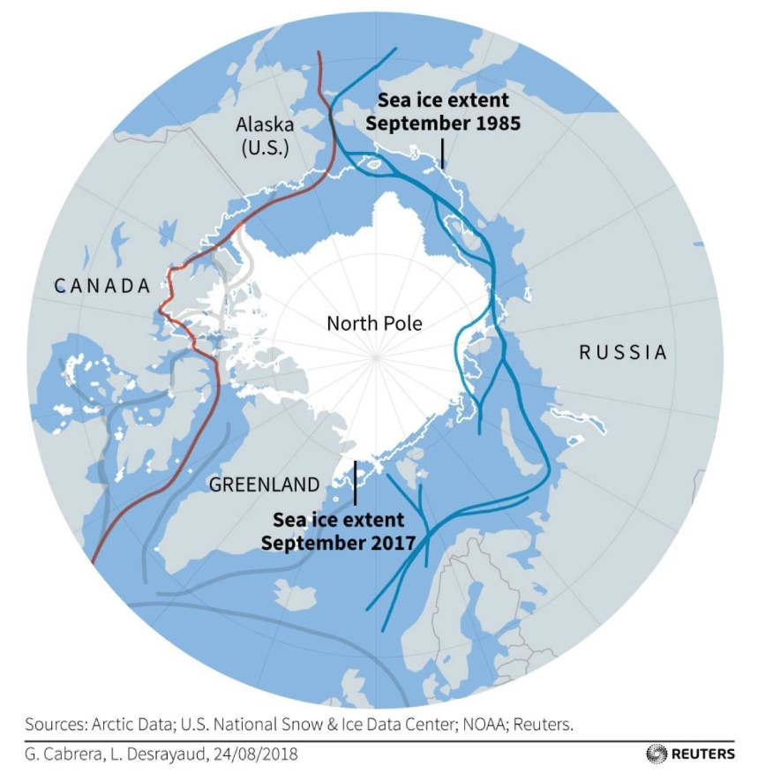
Motivation
The Arctic region
  Arctic Ocean and parts of Alaska, Canada, Finland, Greenland, Iceland, Norway, Russia, and Sweden.
Global Warming
  Area of sea ice coverage each September has declined by more than 40% since the late 1970s
Arctic waterways become more accessible
Greater global attention for its economic opportunities – faster shipping, natural resources
Traffic in the region almost Tripled between 1990-2015[2]
NOT SAFE – COLLISION WITH ICE
[1] https://climate.nasa.gov/vital-signs/arctic-sea-ice/
Part 3- Bioinspired Composite
Notes:
https://i.cbc.ca/1.2568799.1394574696!/fileImage/httpImage/image.jpg_gen/derivatives/16x9_780/ice-conditions-vessel.jpg

Slide 24
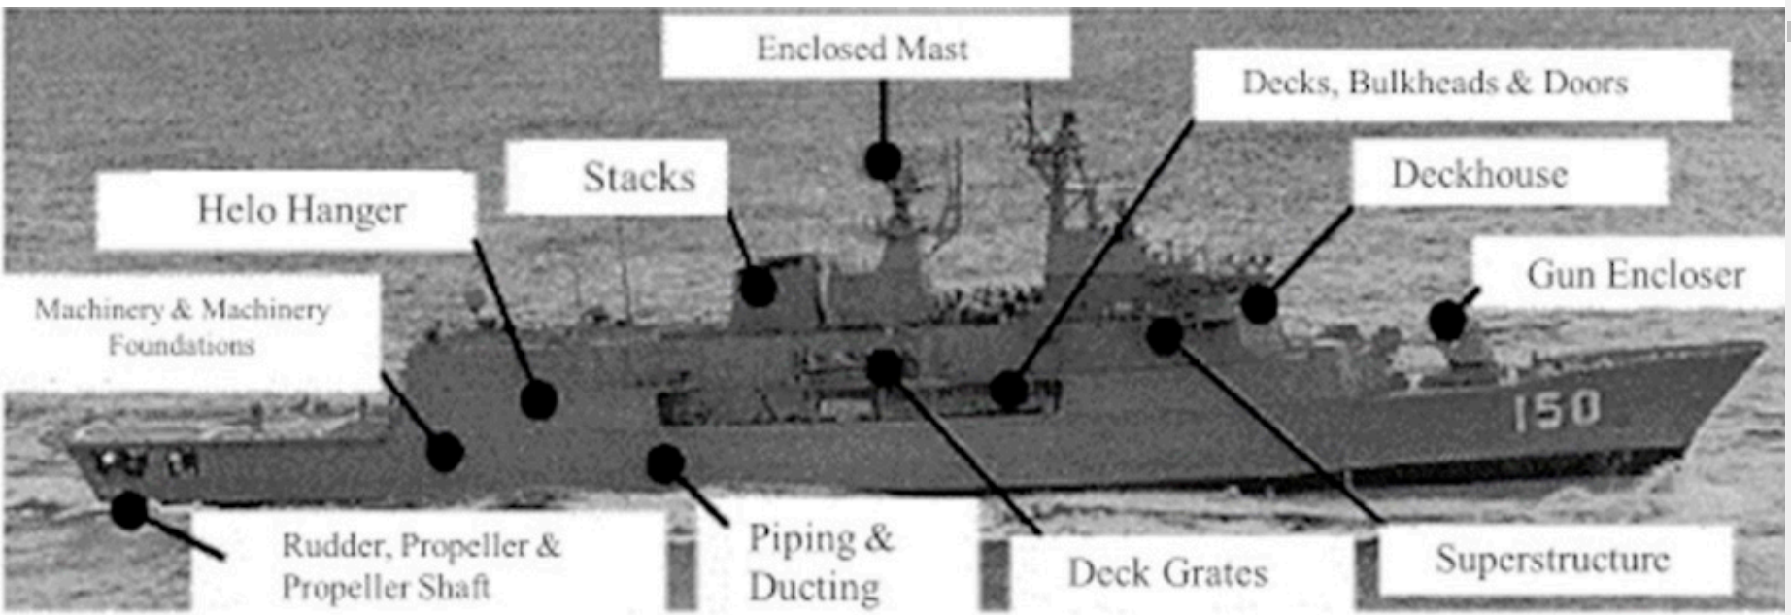
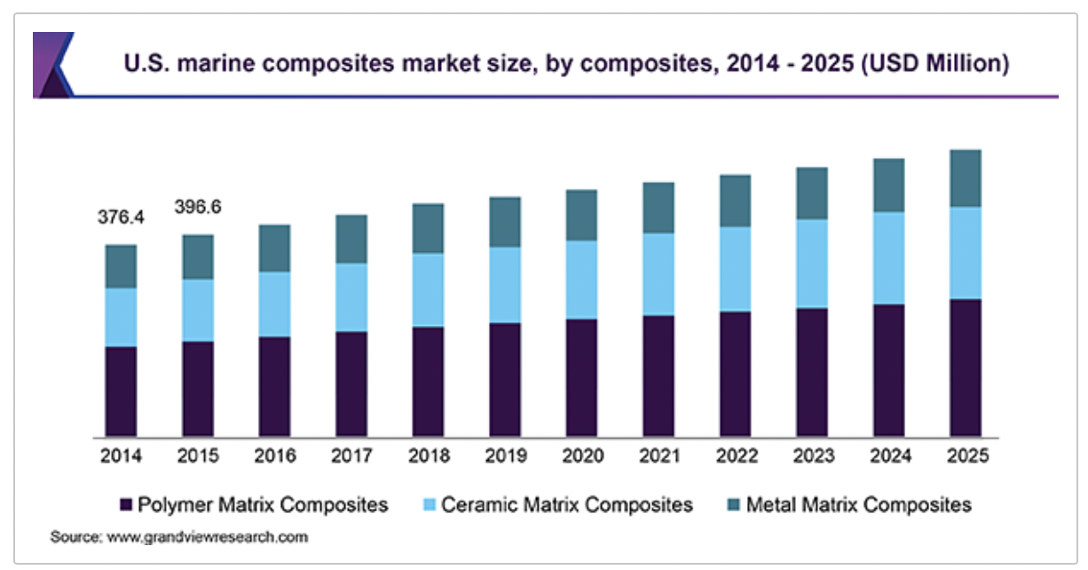
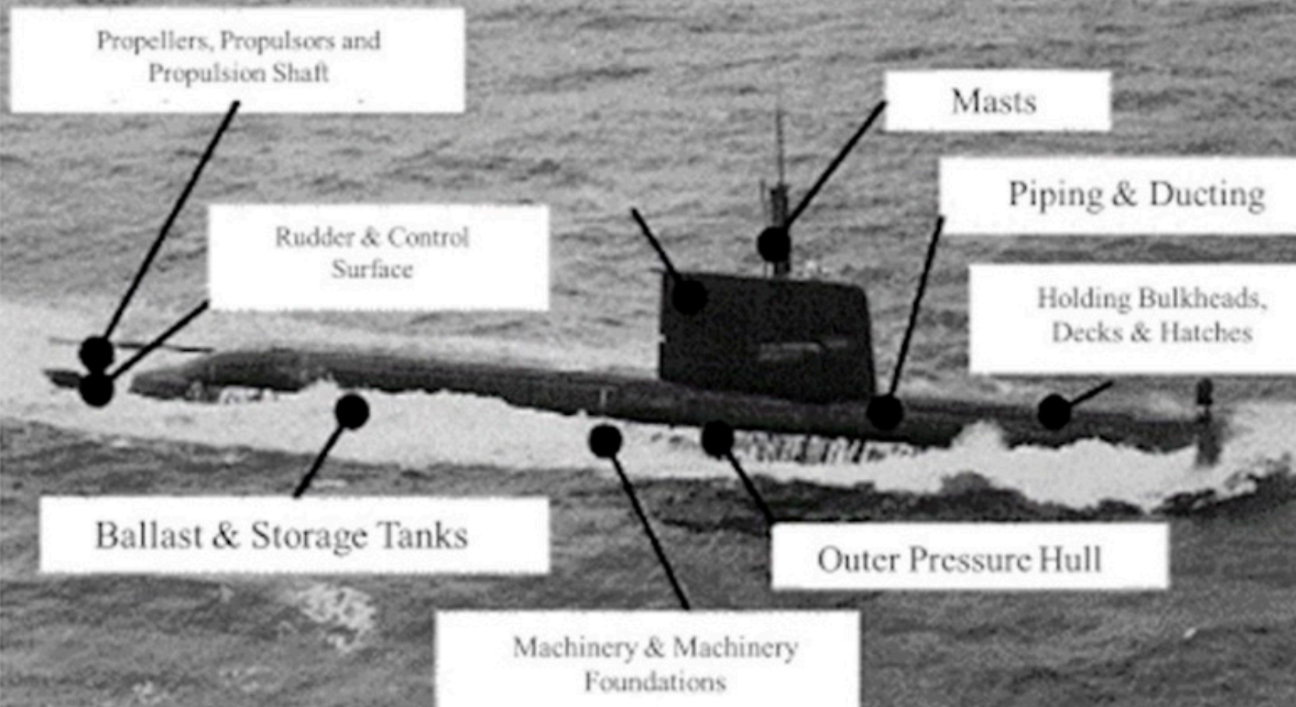
Motivation
Study Impact Damage
  Low Velocity Impact
    1-10 m/s (100 m/s)
    Barely Visible Impact Damage -
    Post impact strength (Residual strength)
Why Composites?
  30-50% weight reduction
  40% higher strength
  Fuel efficient, corrosion resistance, low maintenance, longer durability
$2.5B
[1] Rubino F, Nisticò A, Tucci F, Carlone P. Marine Application of Fiber Reinforced Composites: A Review. J Mar Sci Eng, 2020:8(1).26.
[1]
Part 3- Bioinspired Composite
Notes:
https://i.cbc.ca/1.2568799.1394574696!/fileImage/httpImage/image.jpg_gen/derivatives/16x9_780/ice-conditions-vessel.jpg
BVID for CFRP not for metals.

Slide 25
Objectives
Comparison of Low Velocity Ice Impact on Steel and CFRP specimens at low temperature
Study the influence of temperature and ice on the equienergetic impact behavior (-94˚F)
Design a new bioinspired sandwich composite for the harsh low temperature condition
Part 3- Bioinspired Composite

Slide 26
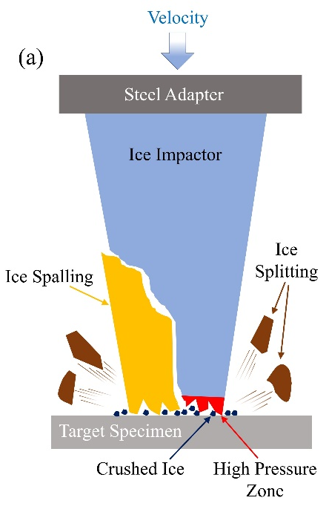
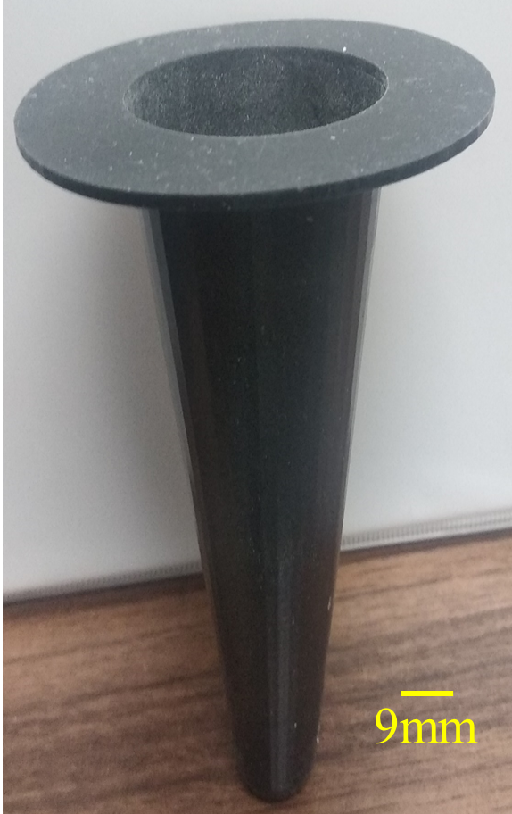
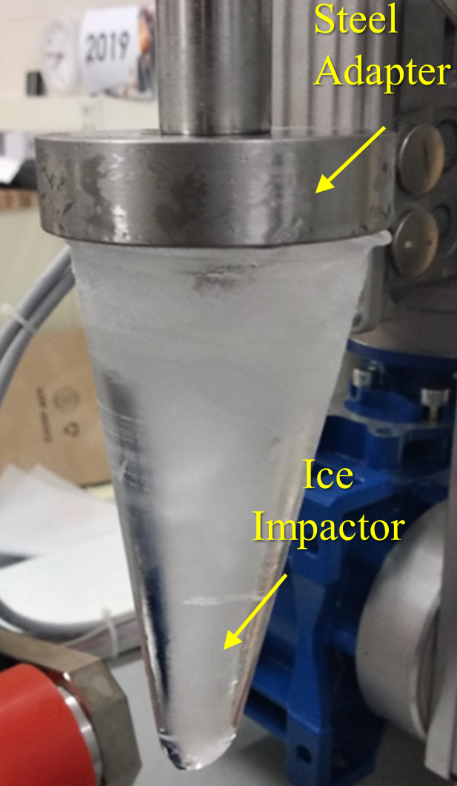
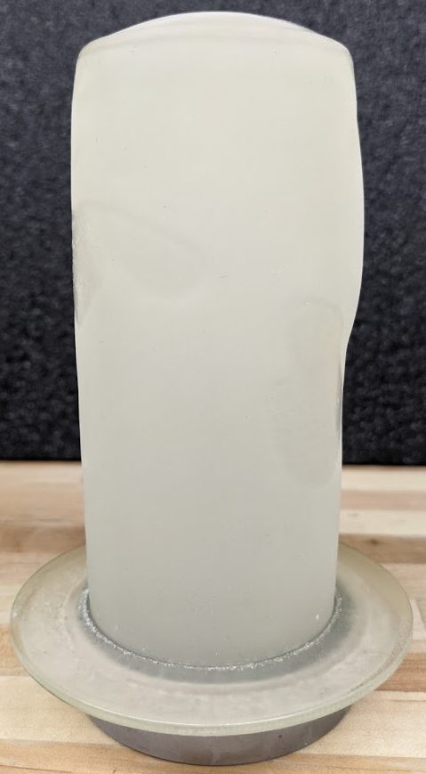
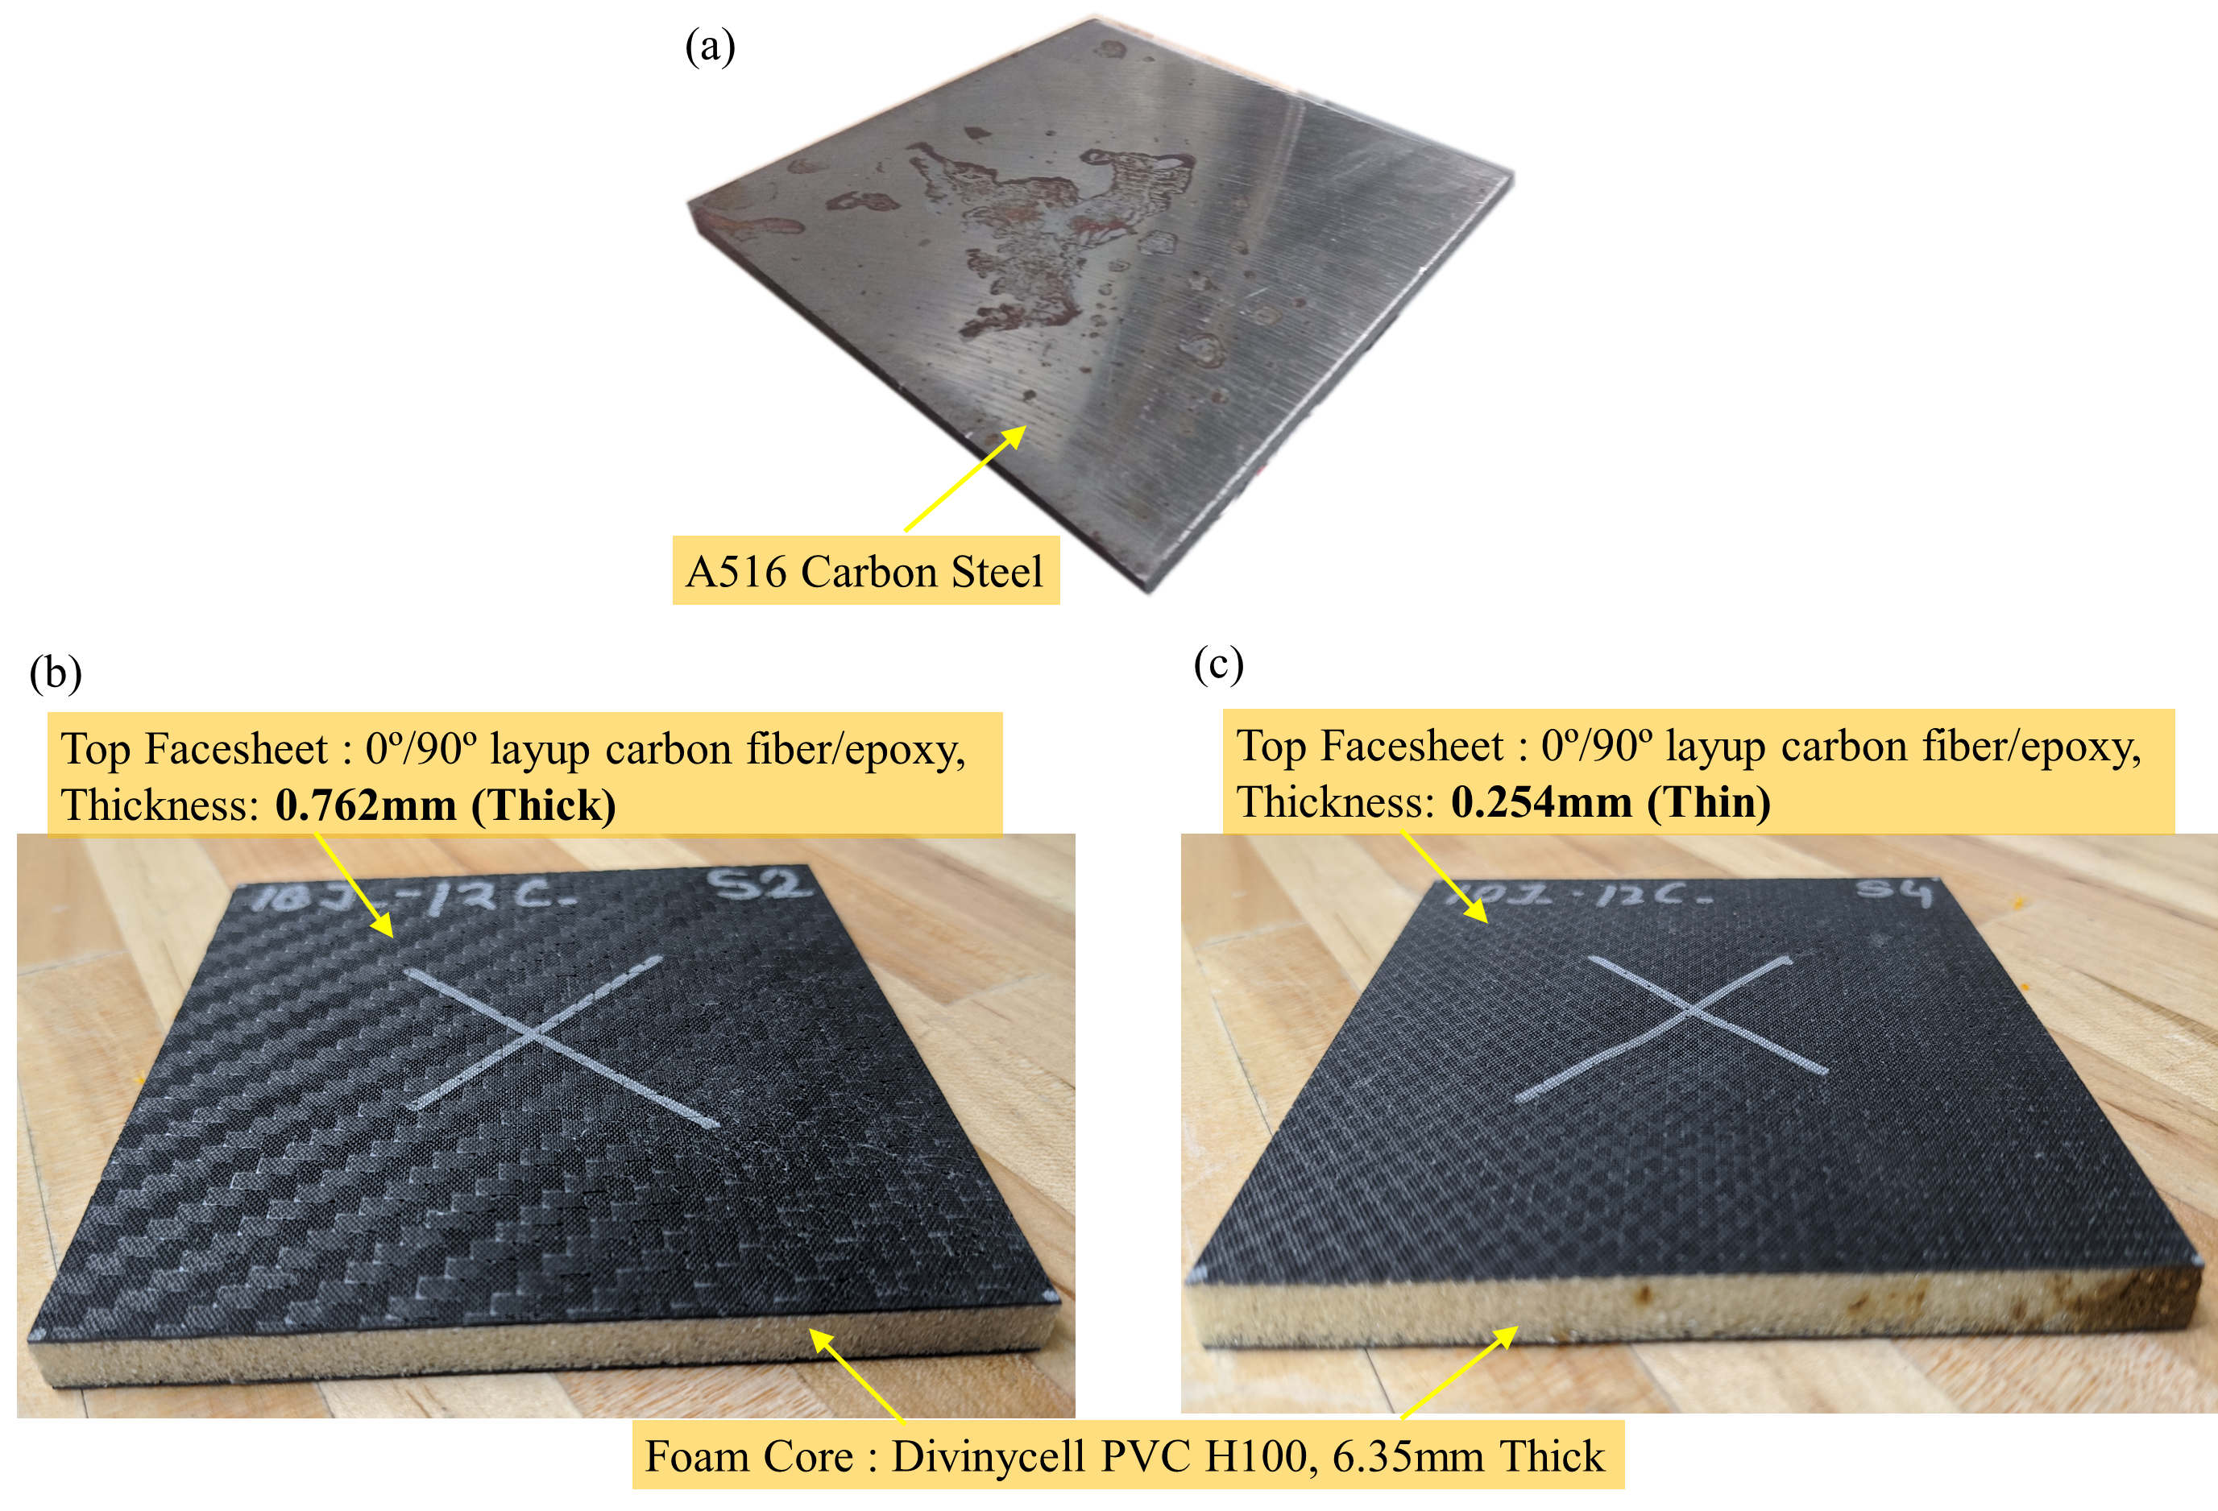
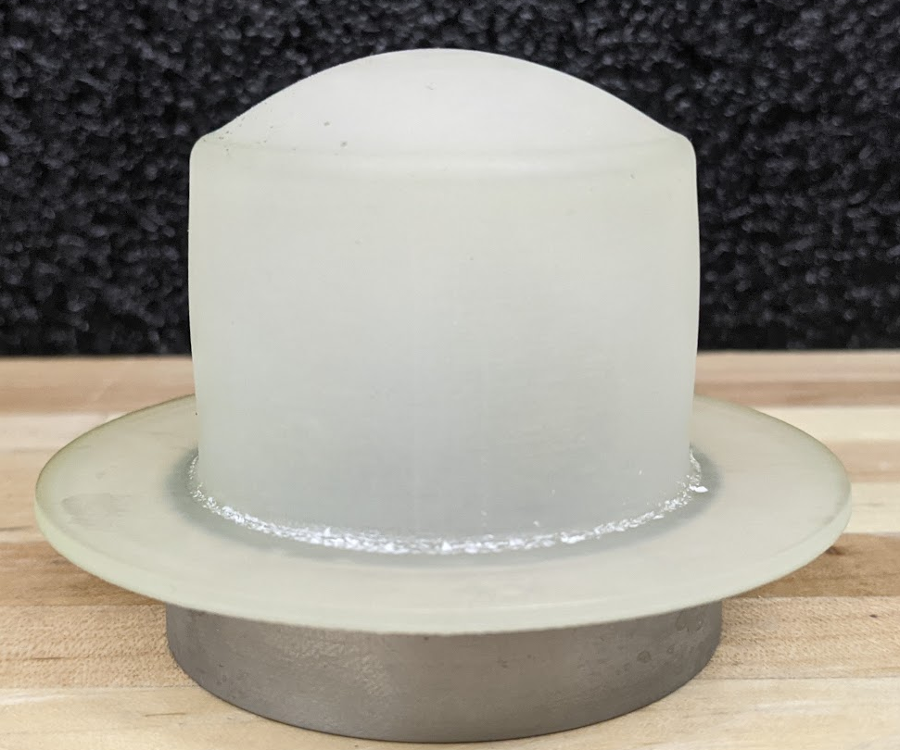
Low Velocity Ice Impact
Analyzed the effect of freezing condition on Ice Impactors
Compared impact performance of Ice Impactors of different Shape and Length
Ice inside mold
Steel Adapter
Target Specimens
Ice Impactor Mold
Carbon Tango Black; 3D printed
Long Cylindrical Ice
Short Cylindrical Ice
Conical Ice
Same Length
  Greater damage from cylindrical impactors than conical shape
Same Volume
Impact Testing, X-ray Micro CT scanning
Part 3 (i) - Bioinspired Composite

Slide 27
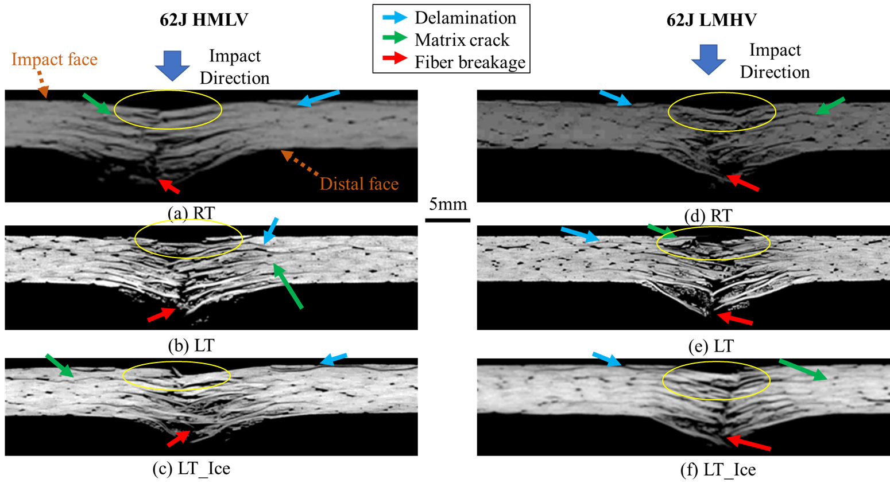
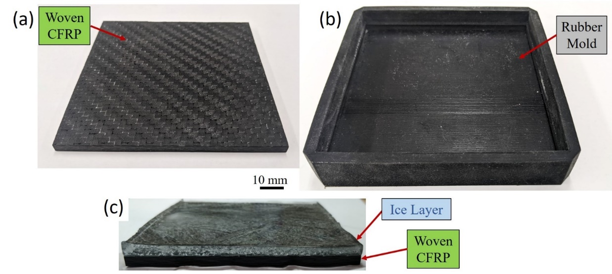
Low Velocity Impact with Ice – Equal Energy Impact
Evaluated the impact response of CFRP under equal energy but at different mass and velocity combinations
Studied the influence of temperature and ice on the equienergetic impact behavior
Impactors with low mass-higher velocity generates greater damage.
Presence of surface ice layer redistributes impact stress on the CFRP specimens and influences damage mechanism.
Mold
  3D printing- Carbon tango black
  Ice on top – 3 mm
  2 days ; -12⁰C
Impact Testing, X-ray Micro CT scanning
Part 3 (ii) - Bioinspired Composite

Slide 28
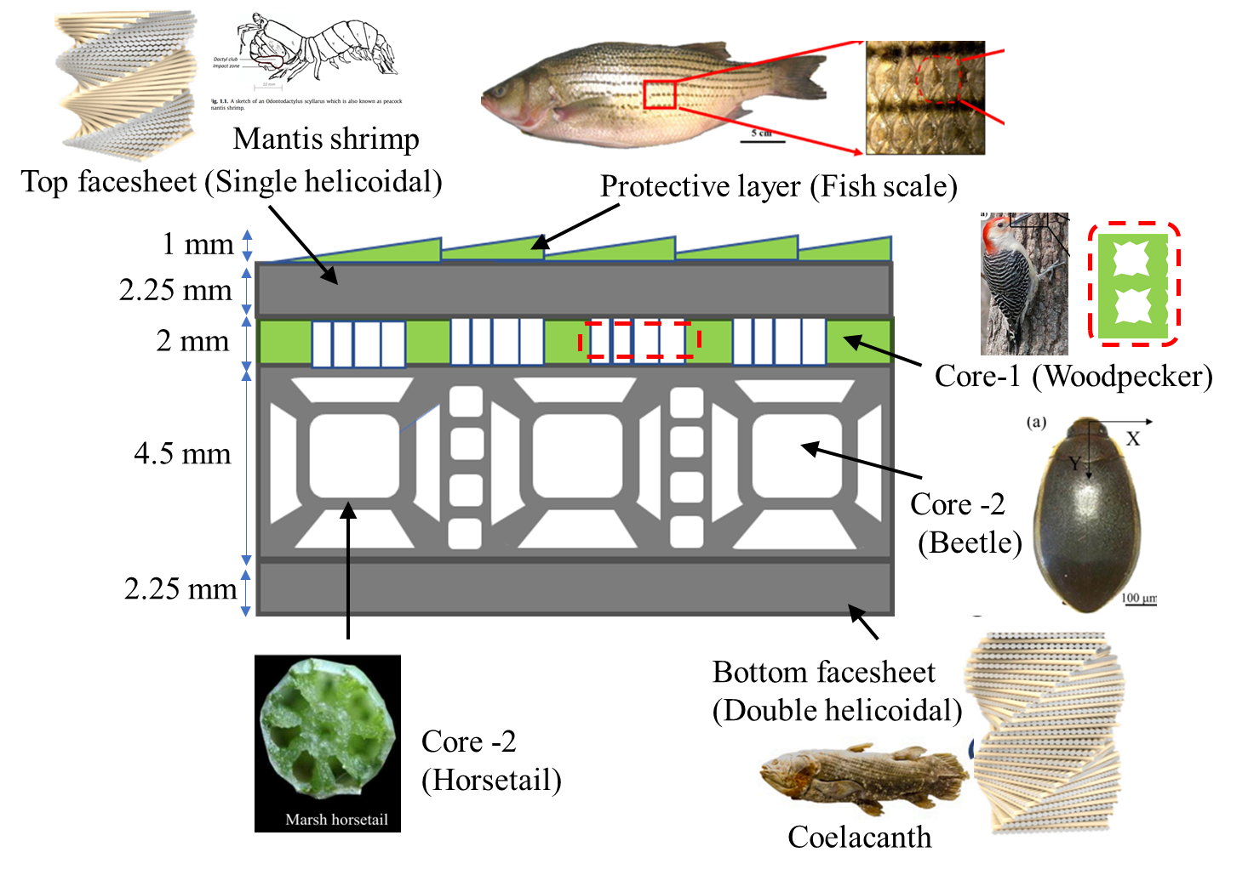
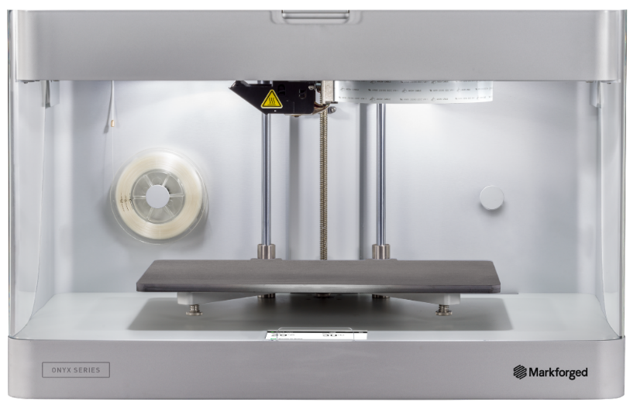
Bioinspired Sandwich Composite (Cont.)
Design a bioinspired sandwich composite using additive manufacturing
Evaluate the impact response at extremely low temperature condition
Carbon/glass fiber
Rubber
Carbon/glass fiber
Markforged Mark Two
Composite 3D Printer
Schematic of proposed bioinspired sandwich composite
Part 3 (iii) - Bioinspired Composite

Slide 29

THANK YOU
Contact information:
Arnob Banik
ab353@uakron.edu
https://www.arnobbanik.com/
https://www.linkedin.com/in/arnob-banik/

